Slide 1
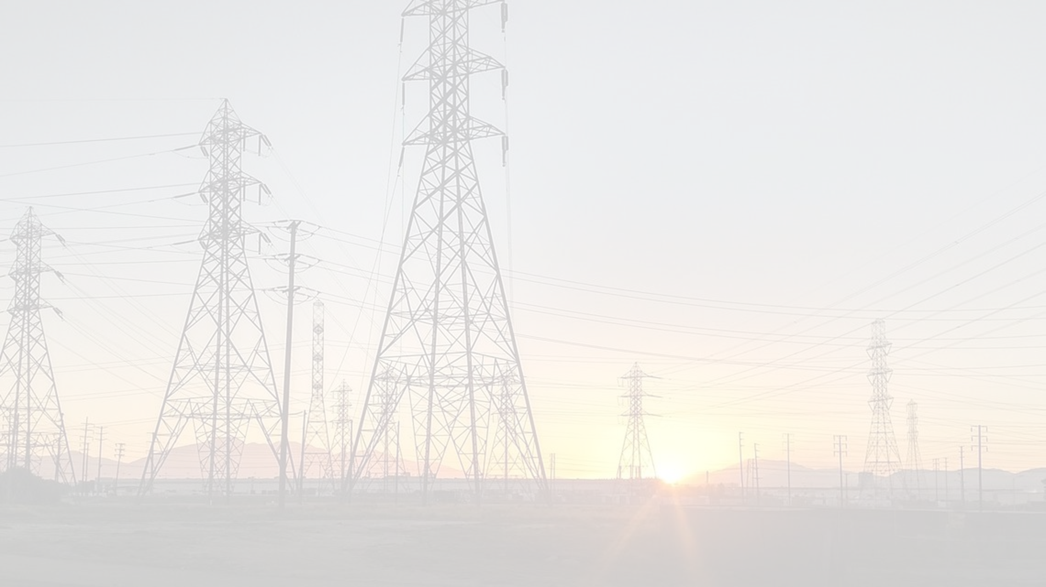


EPIC Workshop
June 27, 2023
The EPIC program is funded by California utility customers under the auspices of the CPUC

Slide 2
Agenda
Introduction (9:00 – 9:15)
  Safety Moment
  Opening Remarks from Commissioner Shiroma
  Welcome from SCE
EPIC III Progress Towards Creating a More Flexible Grid to Maintain Reliability as California Transitions to 100 Percent Clean Energy (9:15 – 10:25)
  PG&E EPIC 3.11: BTM DERs in Microgrids [Arcata Microgrid]
  PG&E EPIC 3.32: System Harmonics for Power Quality Investigation
  SCE GT-18-0019: Distributed Energy Resources Dynamics Integration Demonstration
  SCE GT-18-0017: Service and Distribution Centers of the Future
  SDG&E Project 7: Mobile Batteries
Models for IOU/CEC Collaboration (10:25 – 11:25)
  Current Mechanisms
  Examples of Collaboration
  Needs/Opportunities
  Candidate Future Mechanisms
Additional Questions & Answers (11:25 – 11:55)
Closing Remarks (11:55 – 12:00)

Slide 3

Fireworks Safety (CalFire Link)
Know the Law
  Zero tolerance for illegal fireworks
    Most fireworks that explode, go into the air, or move on the ground in an uncontrollable manner
  Fireworks must carry “Safe & Sane” seal
  Parents are liable for damage their children cause
Safety Tips
  Use state-approved fireworks
  Never use near dry grass or flammable material
  Keep water nearby
  Back up after lighting fireworks
  Don’t wear loose clothing or lean over fireworks being lit

Slide 4
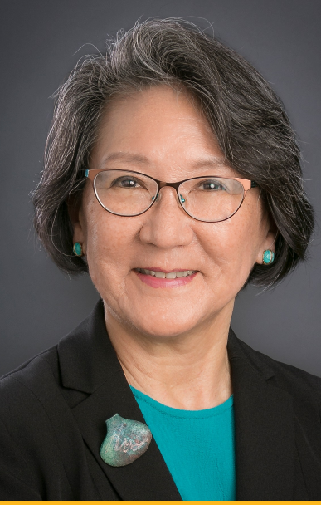
Opening Remarks by Commissioner Genevieve Shiroma

Slide 5
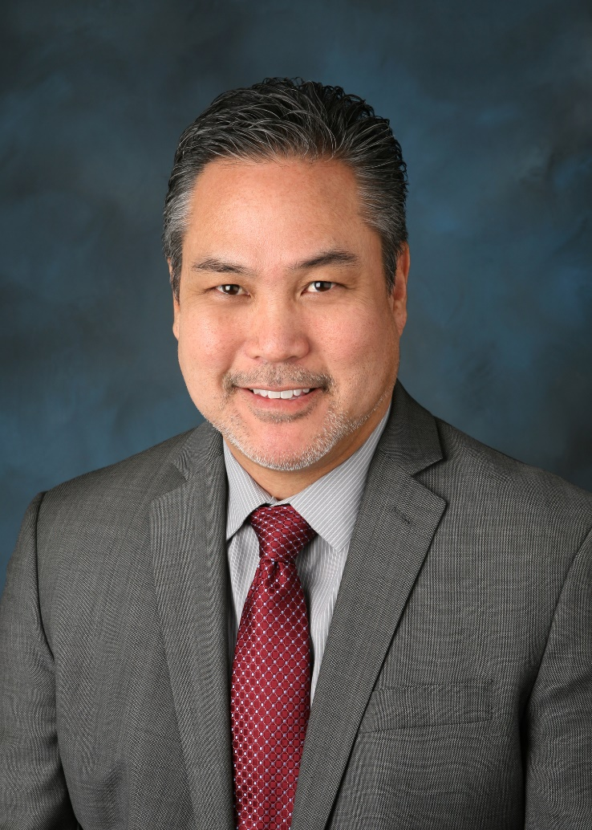
Welcome from SCE Senior Vice President Erik Takayesu

Slide 6
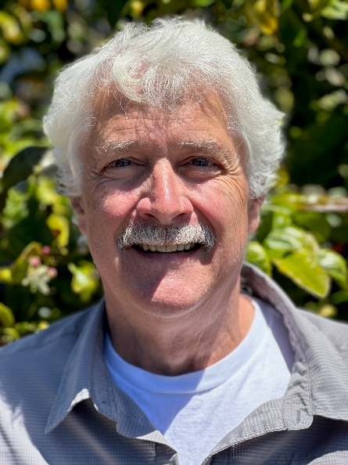
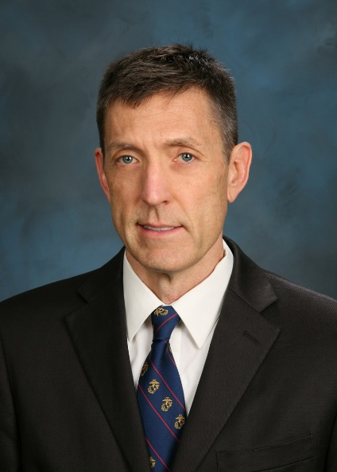
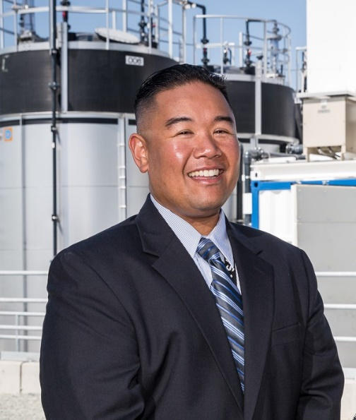
Creating a More Flexible Grid to Maintain Reliability as California Transitions to 100% Clean Energy
Select EPIC III Projects’ Progress
Dave O’Connor
Product Manager, Expert
PG&E
Jordan Smith
Grid Edge Innovation, Consulting Engineer
SCE
Laurence Abcede
Distributed Energy Resources Manager
SDG&E

Slide 7
EPIC 3.11: FTM DERS in Microgrids aka Redwood Coast Airport Microgrid (RCAM)
INTERNAL

Slide 8







RCAM Design and Testing Partners
Development of RCAM required close collaboration among multiple partners
SERC was an excellent partner in bringing experience and expertise to the project
SERC and SEL developed the majority of the microgrid logic/control design
PG&E provided oversight, review, testing, DCC integration, and expertise for input especially around architecture, protection, fail-safes, testing, and roles and responsibilities

Slide 9





RCAM Overview
PG&E Owned and Operated Distribution Circuit at Arcata Airport: Janes Creek 1103
PG&E Owned Islanding Device Controller & Microgrid Controller with PG&E having “primary” control
RCEA (CCA) Owned Generation
  Wholesale: 2.2MW PV & 2.3MW/8.8MWh Storage
  NEM: 320kW PV
Combination of RCEA and PG&E Customers
  175kW Average Load with Typical Range of 125-360kW
  29 kW RCEA EV Chargers
PG&E Islanding Device
LR 136680
To Sub
PG&E Janes Creek 1103 Circuit End of Line
Islanding Recloser Relay
PG&E Microgrid Control Panel (Primary)
RCEA NEM PV
RCEA EV Chargers
RCEA Microgrid Control Panel
RCEA Generation
Circuit Breaker
Other Customers
PG&E Responsibility
RCEA (CCA) Responsibility
RCEA Wholesale Generation (2.2 MW)

Slide 10
EPIC 3.11 Contributions to CPUC’s ESJ Action Plan
“Consistently integrate equity and access considerations throughout CPUC proceedings and other efforts.”
RCAM is a blueprint for future multi-customer microgrids
“Increase investment in clean energy resources to benefit ESJ communities, especially to improve local air quality and public health.”
RCAM is 100% clean energy
“Strive to improve access to high-quality water, communications, and transportation services for ESJ communities.”
EV Charging is a growing part of RCAM and energizes a critical regional airport
“Increase climate resiliency in ESJ communities.”
RCAM has shown proven reliability facing storms and earthquakes

Slide 11
RCAM’s Impact on the Future of Microgrids
Inverter based protection schemes
Operating parameters and technical studies for microgrids
Microgrid Operating Agreement
Community Enablement Tariff
Community Microgrid Enablement Program
Microgrid Incentive Program for $200M to go towards kickstarting microgrid enterprises to provide clean and resilient energy for those that need it the most
Notes:
RCAM/EPIC 3.11 Provided:

Slide 12
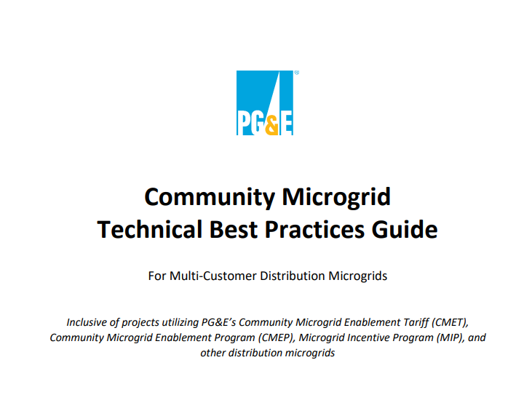
Part of the EPIC 3.11 Heritage
“The current version of this Guide is based largely on the Redwood Coast Airport Microgrid in McKinleyville, California, because that is the first multi-customer Community Microgrid that has been deployed and is functional and operating on PG&E’s Distribution System.”
https://www.pge.com/pge_global/common/pdfs/residential/in-your-community/community-microgrid/pge-community-microgrid-technical-best-practices-guide.pdf

Slide 13
PG&E is continuing to advance microgrid research and development
EPIC 3.11 - Location Based DERs (RCAM) Direct Follow-On Activity
Test new microgrid controllers
Evaluate mid-feeder microgrids
Develop advanced protection schemes
EPIC 3.11b – Foresthill Distribution Microgrid Pilot
Explore technical solutions to control BTM DERs for resiliency​
Develop and implement standard and operational processes for use-cases, including Cleaner PSPS support
Notes:
Proposed and Active Microgrid Research:

Slide 14

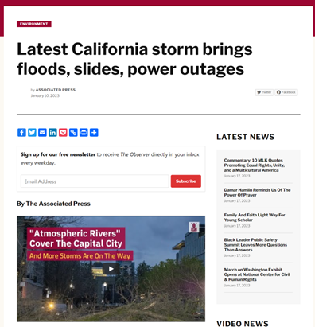
RCAM has performed as designed across a variety of hazard scenarios
6.4 Earthquake Dec. 20th, 2022
“Storm Parade” Jan. 4th, 2023
Notes:
But we want to start with these headlines.
When it mattered, RCAM has performed as designed across multiple hazard scenarios.
Transitioning seamlessly and automatically to provide resilience to Critical Facilities like the Regional Airport and the Coast Guard during emergency events. This is the "Reason of Being" for these microgrids and why PG&E (and California at large) is committing so many resources and dollars to Community Microgrids. The punchline is: we were very pleased with what we saw.

Slide 15
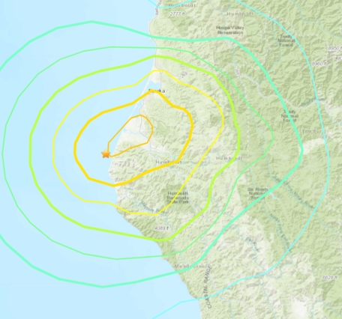
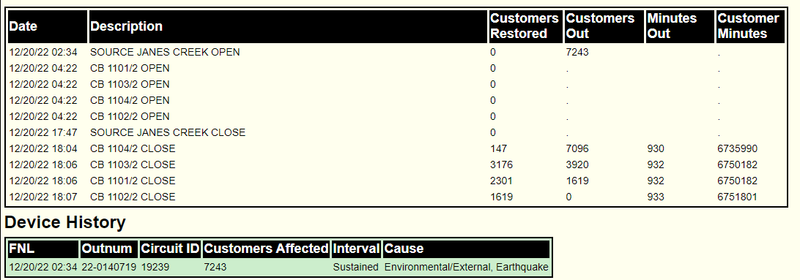
Earthquake: 2:34am Dec. 20th, 2022
6.4 Magnitude with an epicenter 39 miles South-Southwest of project site
70,000 PG&E customers out in the region including 7,243 on Janes Creek 1103.
RCAM immediately detected line loss and transitioned automatically and seamlessly to islanded mode.
BESS hit min state of charge at 17:22 and microgrid was de-energized. Airport and Coast Guard moved to diesel gen backup
Power Restored, 15h:33m later
Notes:
So, Let's start with the Earthquake:
On Dec. 20th, 2022, at 2:34 AM, a 6.4 Magnitude earthquake hit just 39 miles south of the RCAM site.
As a result, 70,000 PG&E customers lost power, including the 7,243 customers on the Janes Creek 1103 - the circuit which feeds the Airport and Coast Guard Air Station. RCAM immediately detected loss of source power and transitioned to islanded mode seamlessly and automatically, without any human intervention.
The RCAM Generator kept the Airport and Coast Guard energized for 15hrs and 44 mins. Until the battery hit the 5% minimum state of charge at around 5:30 and stopped supplying energy into the microgrid. At which time, the Airport and Coast Guard were de-energized and diesel generators were used as back-up. This was all coordinated with the airport and Coast Guard well in advance. Normal power to Janes Creek was restored just 44 mins later.
So, in our first emergency event, we have a little bitter with the sweet. We transitioned and energized the microgrid but We lost power just short of re-energization time. And we’ll get to those reasons and lesson in a few slides.

Slide 16
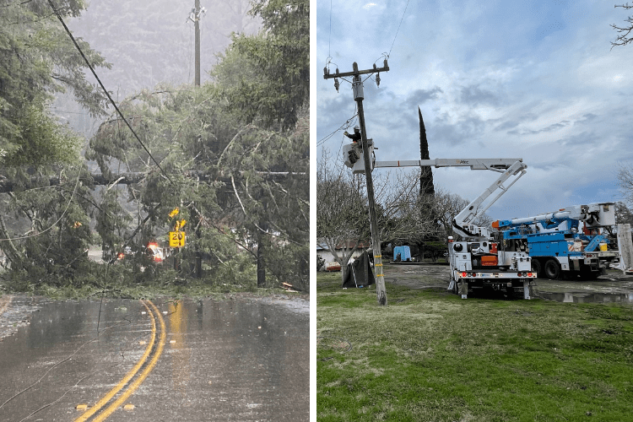
Storm Outage: 7:15am Jan. 4th, 2023, Janes Creek
Tree fell across all three phases of Janes Creek 1103.
Significant storm related outages across Norther California: 3,079 PG&E customers impacted.
RCAM immediately detected line loss and transitioned automatically and seamlessly to islanded mode.
Power was restored, 8hs 16min later.
Notes:
So quick change of focus to our next event.
On Jan 4th at 7:15 AM. Was the longest storm-related sustained outage when a tree fell across all three phases of Janes Creek 1103.
3,079 PG&E customers were impacted on Janes Creek, with significant other storm related outages across out territory.
As with the Earthquake, RCAM automatically and seamlessly transitioned. Power was restored, 8hs 16min later. Unlike the Earthquake, RCAM rode out this outage and successfully (automatically and seamlessly transitioned back to grid connected.
Tree fell across all three phases of Janes Creek 1103.
3,079 PG&E customers impacted. Significant storm related outages across Norther California.
RCAM immediately detected line loss and transitioned automatically and seamlessly to islanded mode.
Janes Creek 1103 power restored across entire feeder at 15:32.
Automatically and seamlessly transitioned back to normal source after successfully energizing the Microgrid through entirety of 8h 16m sustained outage

Slide 17
EPIC 3.32: System Harmonics
INTERNAL

Slide 18
System Harmonics Issue
Increase in customer complaints
Reactive, inefficient, and resource-intensive data collection
Seasonal issue
Extensive analysis to determine root causes
Notes:
Issues Addressed
1. PG&E is seeing a significant increase in customer complaints related to harmonics in recent years resulting in the need to collect harmonics data on a large scale to assess the size and importance of the issue, and potential proactive actions for PG&E.
2. The current process of collecting harmonics data is reactive, inefficient, and consumes significant resources from Restoration and Power Quality departments.
3. Harmonics issues in PG&E distribution systems are seasonal, therefore long-term monitoring and data are required to get a complete picture and identify the sources of harmonics.
4. Power Quality investigation of harmonics issues requires extensive harmonics data and analysis to determine the root cause because it impact the whole feeder issue. Automated and analysis tools are needed to investigate which would pay way to resolve customer harmonics complaints in a timely manner.

Slide 19
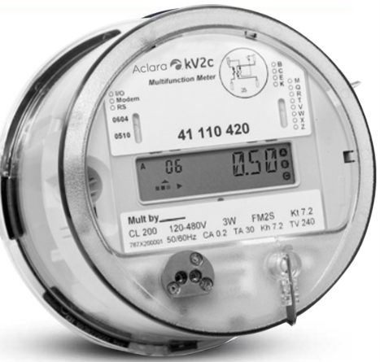


Project Objectives
Demonstrate the feasibility of using Advanced Meter with Power Quality (AMPQ) to collect harmonics data and assess the potential value that AMPQ can provide for Power Quality investigation.
Determine the size of the harmonics issues in PG&E distribution systems.
  Where are the harmonics issues and when do they occur?
  What is the root cause(s) of the harmonics issue?
Build a harmonics dashboard and analysis tools that Power Quality engineers can use to monitor, investigate, and assist in resolving harmonics issues.
Monitor harmonics in distribution systems
Proactively detect feeders with high harmonics
4G LTE
Harmonics
Data Collection
Server
Harmonics
Dashboard
Cellular
Resolve customer complaints
4G LTE

Slide 20
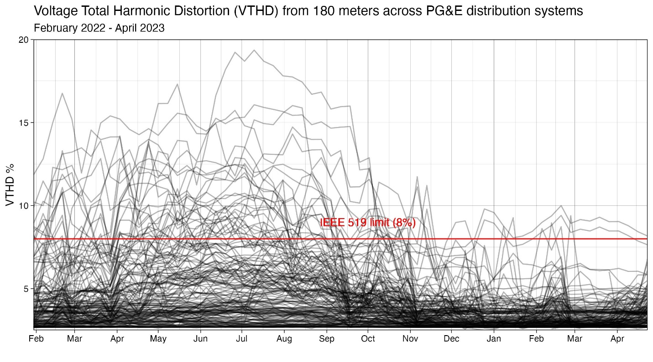
Key Results
The AMPQ can reliably collect harmonics data on a large scale at a lower cost than RVM/PQM (Unit cost of AMPQ >$1000 vs ≈$10,000 for RVM/PQM and AMPQ can transmit the data remotely)
33 of 125 selected distribution feeders have harmonics level exceeding IEEE 519 limit during the monitoring period. Many of these feeders (10-15 feeders) were not on PG&E’s radar.
10 feeders have very high harmonics level up to 15 – 20% total voltage harmonic distortion (VTHD) that will likely impact customer equipment now or in the future if customer installs sensitive equipment.
Notes:
The AMPQ can reliably collect harmonics data on a large scale at a lower cost than RVM/PQM (Unit cost of AMPQ >$1000 vs ≈$10,000 for RVM/PQM and AMPQ can transmit the data remotely)
33 of 125 selected distribution feeders have harmonics level exceeding IEEE 519 limit during the monitoring period. Many of these feeders (10-15 feeders) were not on PG&E’s radar.
10 feeders have very high harmonics level up to 15 – 20% total voltage harmonic distortion (VTHD) that will likely impact customer equipment now or in the future if customer installs sensitive equipment.

Slide 21
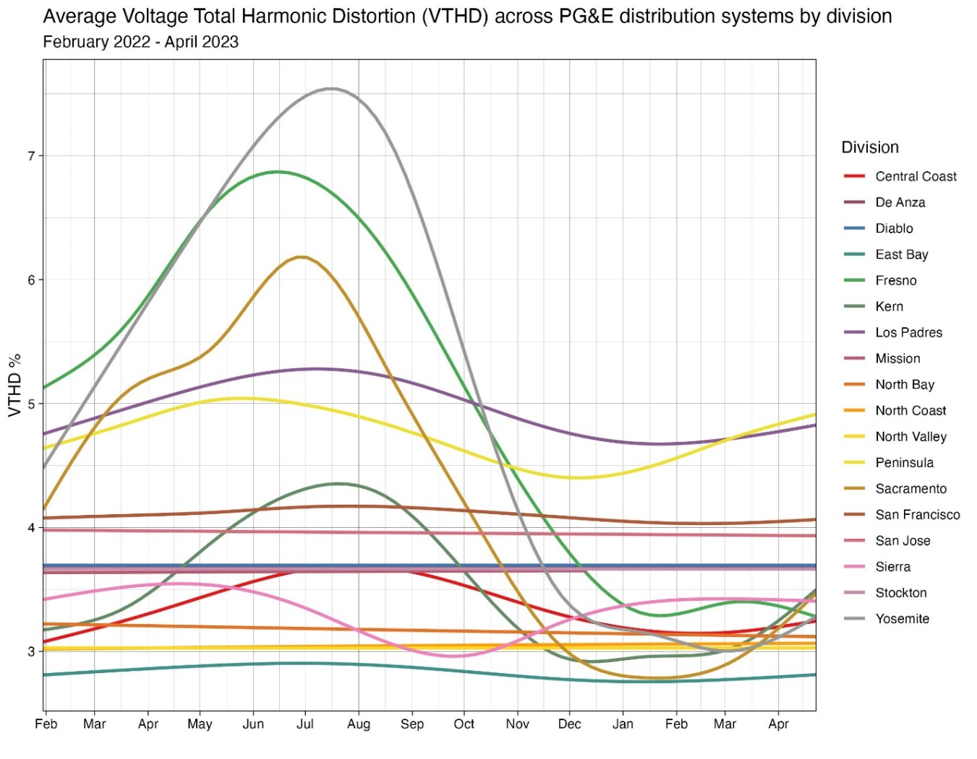
Key Findings
Feeders in the Agricultural areas (Fresno, Sacramento, Yosemite) show significant increase in harmonics during irrigation season. These Divisions consist largely of DACs.
The increase in harmonics correlates directly with increase in irrigation loads on agricultural feeders.
Non-agricultural feeders have generally flat harmonics through the year.
Variable Frequency Drives (VFD) are the direct cause of the current harmonic issues in PG&E distribution systems. Solar PV and EV chargers currently do not produce a significant harmonics issues—yet.
PG&E can address the harmonics issues with policy and technical solutions targeting the VFDs.
Yosemite
Fresno
Sacramento
Notes:
Feeders in the Agricultural areas (Fresno, Sacramento, Yosemite) show significant increase in harmonics during irrigation season. These Divisions consist largely of DACs.
The increase in harmonics correlates directly with increase in irrigation loads on agricultural feeders.
Non-agricultural feeders have generally flat harmonics through the year.
Variable Frequency Drives (VFD) are the direct cause of the current harmonic issues in PG&E distribution systems. Solar PV and EV chargers currently do not produce a significant harmonics issues—yet.
PG&E can address the harmonics issues with policy and technical solutions targeting the VFDs.

Slide 22
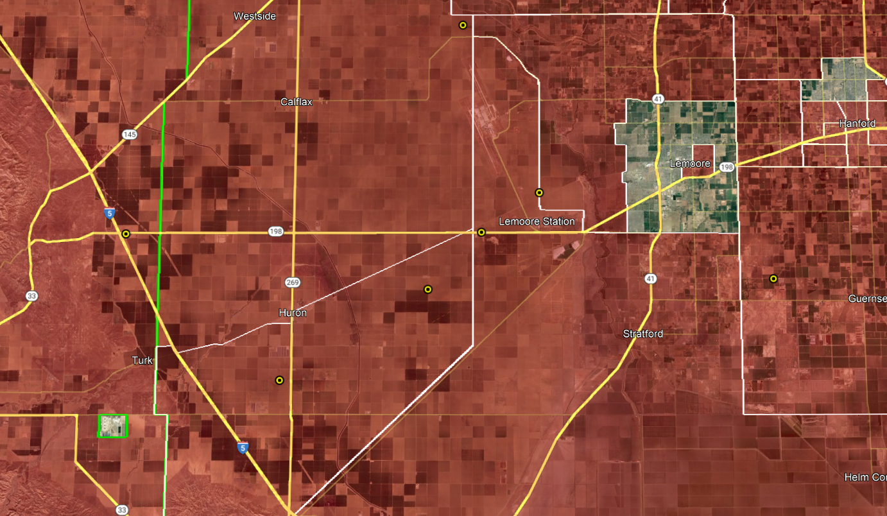


Typical Infrastructure Distribution in Fresno Division
EPIC 3.32 Meter
Solar Farm
DAC

Slide 23
Strategic Value and Benefits of AMPQ
Greater Reliability
Ability to obtain high-resolution harmonics data to proactively monitor, detect, and mitigate harmonics issues impacting PG&E and customer equipment.
Increased Safety
Reduce exposure to high voltage for field personnel with installation of RVM and PQM.
Lower Costs
Reduce truck rolls and cost of harmonics data collection.
Societal Benefits
Facilitate adoption of PV/DER and EV chargers where harmonics could otherwise become a limiting factor by increasing costs to customers.
Customer Satisfaction
Improve customer satisfaction where harmonics prevent customer equipment to operate correctly by resolving harmonics complaint in a timely manner

Slide 24
Moving Forward
Explore use of existing smart-meter and AMI platform
Adapt business process/practices
Improve the scalability and maintainability harmonics dashboard and create more analysis tools
Advance two harmonics mitigation pilot projects
Potentially pursue IP position
Leverage EPIC 3.32 data to evaluate the impact of harmonics on PG&E distribution assets
Support Industry Alignment
AMI 2.0, harmonics mitigation equipment, potential EPIC 4 project
Notes:
Explore use of existing smart-meter and AMI platform. End-to-end testing has been successfully completed
Adapt business process/practices
Improve the scalability and maintainability harmonics dashboard and create more analysis tools to help automate harmonics analysis for PQ engineers
Two harmonics mitigation pilot projects
Harmonics filter (the project is beginning)
Harmonics cancelling transformer (supply chain constraints)
Potentially pursue IP position for collection and analysis of harmonics data.
Use harmonics data from EPIC 3.32 to evaluate the impact of harmonics on PG&E distribution assets such as capacitor bank and transformer (overload, premature failures, abnormal operations).
Work with other utilities (SCE and SDG&E harmonics taskforce) and industry on harmonics strategy
AMI 2.0, harmonics mitigation equipment, potential EPIC 4 project?

Slide 25
Recommendations
Incorporate harmonics data collection into 3,000 – 4,000 smart-meters installed at large customers to get visibility of harmonics level in all distribution feeders.
Focus engineering and policy solutions on VFDs on ag feeders and ag customers
Create a process to monitor and resolve harmonics issues in distribution systems in anticipation to expected increase in harmonics level and sensitive loads that are underway (DER, Solar and EV).
Evaluate and standardize harmonics mitigation equipment
Notes:
Incorporate harmonics data collection into 3,000 – 4,000 smart-meters installed at large customers to get visibility of harmonics level in all distribution feeders.
Both harmonics policy and engineering solutions should target VFDs on ag feeders and ag customers to address harmonics issues
Create a process to monitor and resolve harmonics issues in distribution systems in anticipation to expected increase in harmonics level and sensitive loads that are underway (DER, Solar and EV).
Evaluate and standardize harmonics mitigation equipment such as harmonics filter and harmonics cancelling transformer into PG&E approved equipment.

Slide 26
Thank You
Questions?

Slide 27
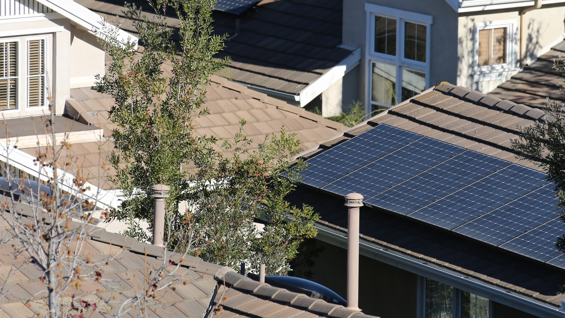
Distributed Energy Resources Dynamics Integration Demonstration

Slide 28
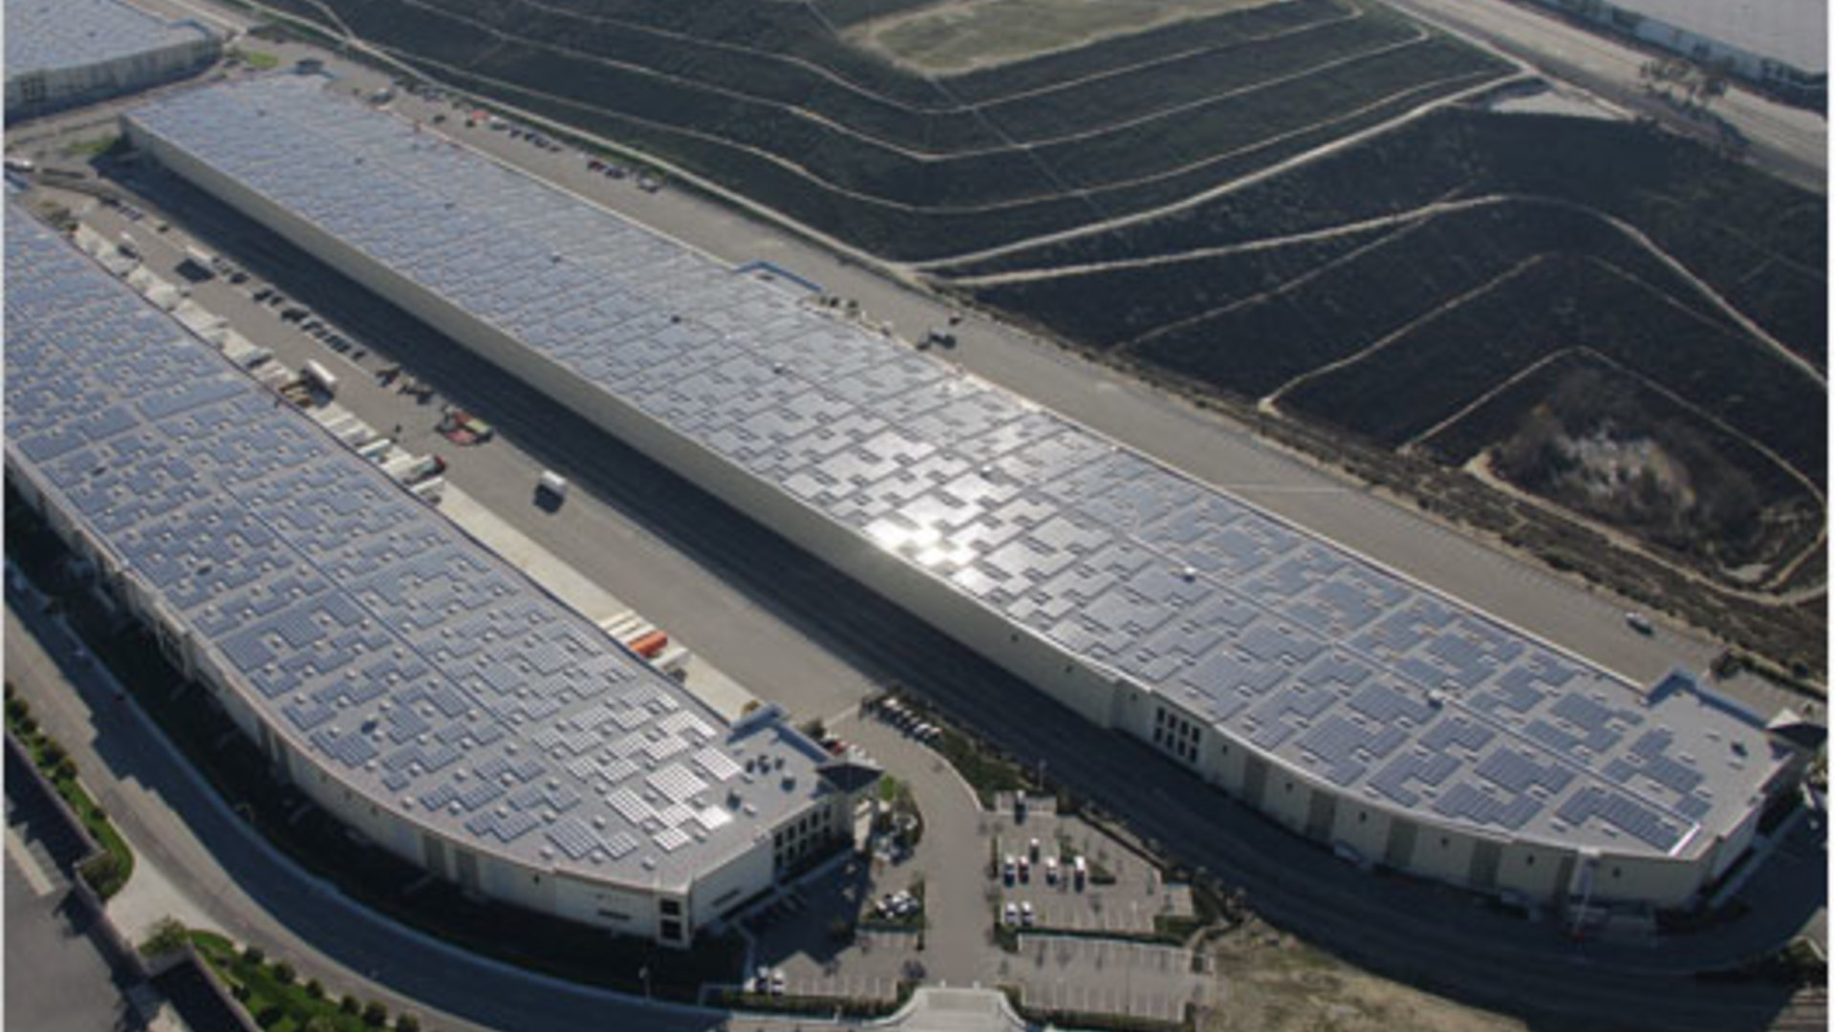
Overview
Opportunity and Scope
Evaluate both the ways the proliferation of DERs impacts the feeder protection system and the interactions between inverter-based and non-inverter-based DERs
This project has performed a detailed PSCAD modeling and simulation study of the PV-based system followed by power hardware-in-the-loop (PHIL) testing
Deliverables
Understanding of how high penetration of Rule 21 smart inverters and IEEE-1547 2003 legacy inverters affects SCE’s relaying feeder protection systems
Observing the interaction between traditional DERs and smart inverter-enabled DERs with advanced functions and the impacts on feeder protection systems
Analyzing interaction between multiple models of inverter using different anti-islanding detection algorithms
Finding whether increased DER penetration necessitates new protection settings

Slide 29
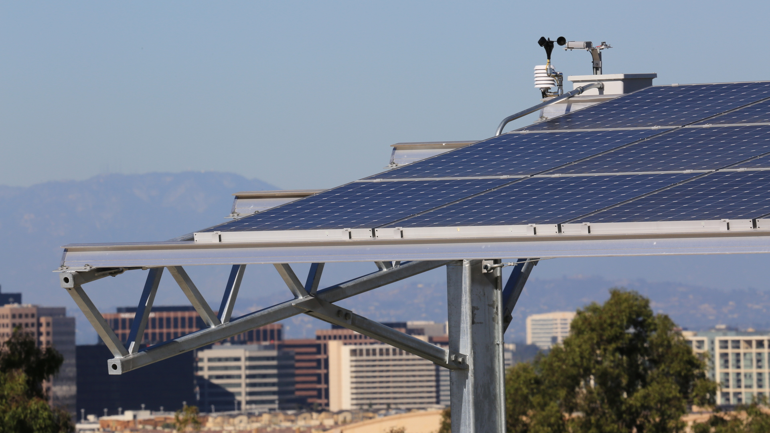
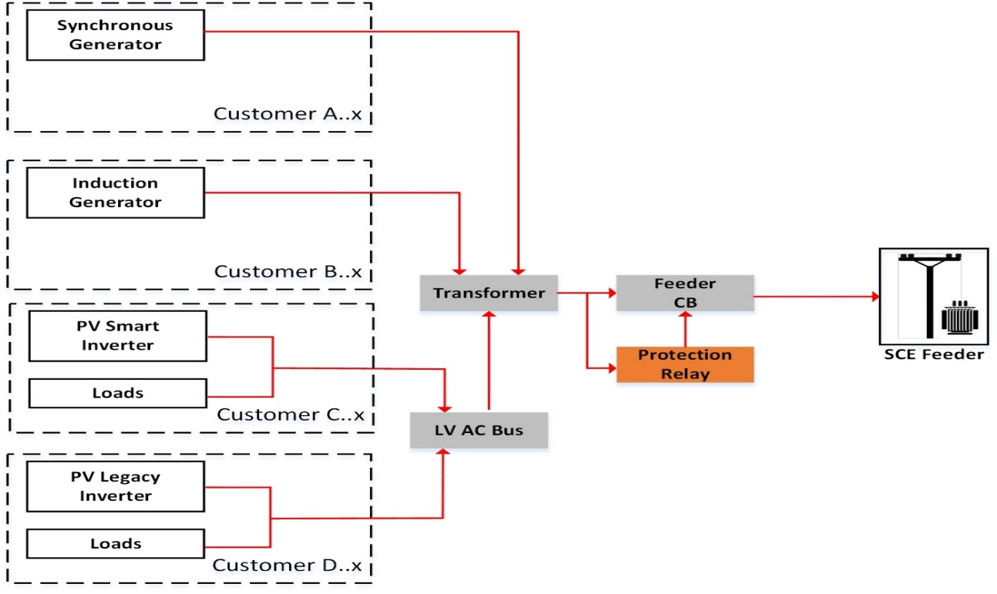
Simulation
Feeder – DER integrated feeder
Equipment – Standard rated
Load – Peak load on a hot day

Slide 30
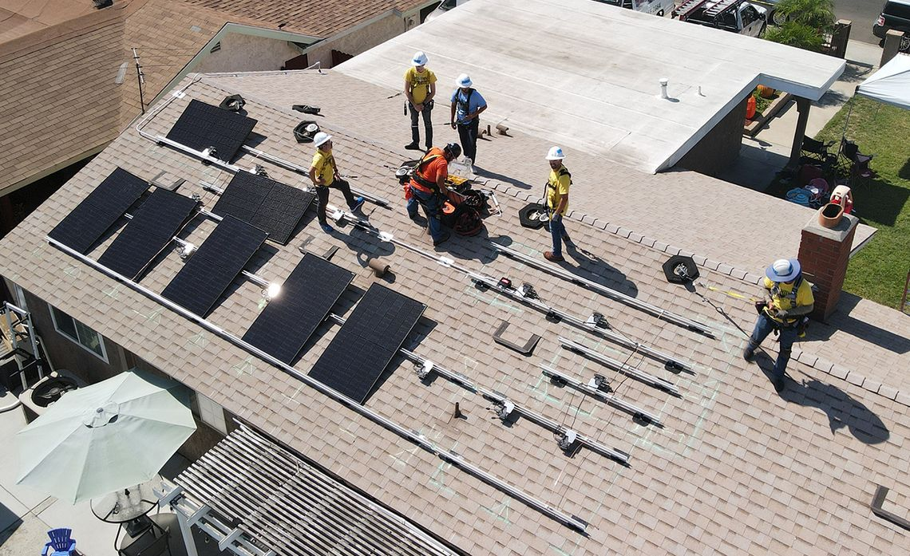
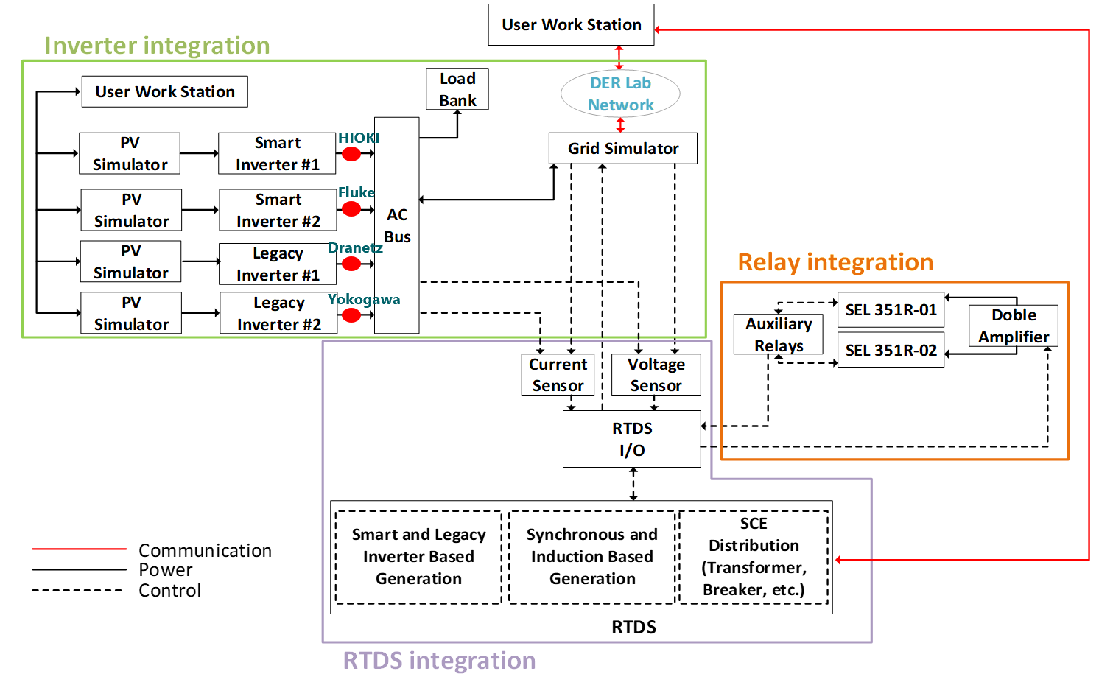
Demonstration
Subsystem –Inverter, relay, RTDS
Equipment –Relay, sensor, inverter
Protection – SEL 351R

Slide 31
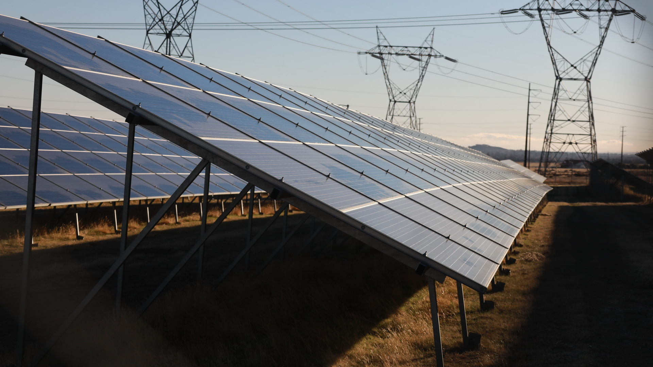
Findings
High DER Integration: At up to 120% of DER penetration, the present protection setting is optimal
Interaction Between DER: VRT and FRT worked as expected except one inverter
Anti-Islanding Algorithm: Sandia Voltage Shift is preferable to Sandia Frequency Shift
New Protection Method: No new protection method is required

Slide 32
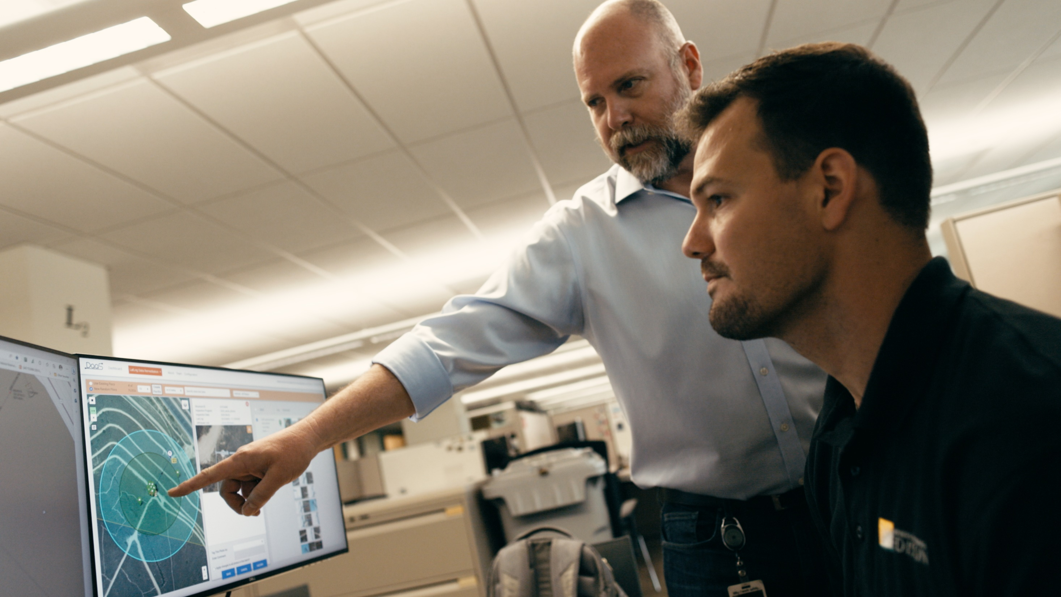
Stakeholders and Future Plans
Stakeholders
  Internal: Protection and Distribution System Analysis
  External: CPUC, PG&E, SDG&E
  Working Groups: UIWG, SIWG, NREL
  Industry and Academia: IEEE, APEC, Hybrid and EV Technologies Symposium
Potential EPIC 4 Plans
  Simulation and demonstration of synthetic inertia using Inverter-Based Resources (IBRs)
  Investigate further on anti-islanding efficacy
  Evaluate the protection impact of different distribution relays that SCE uses

Slide 33
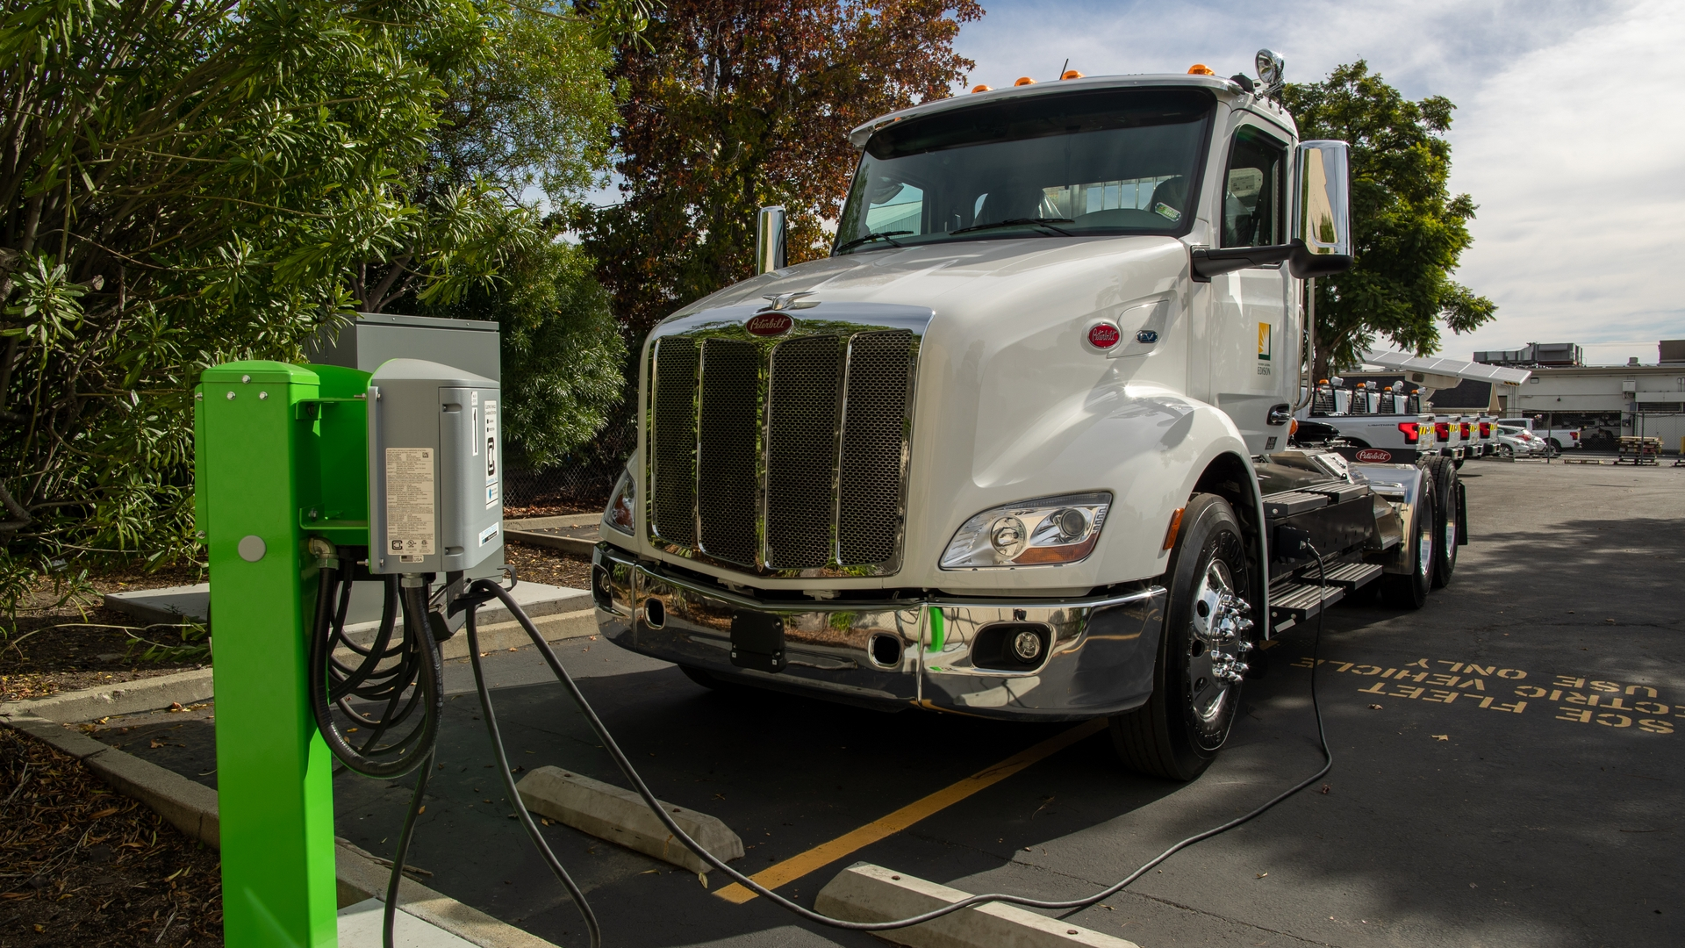
Service and Distribution Centers of the Future

Slide 34
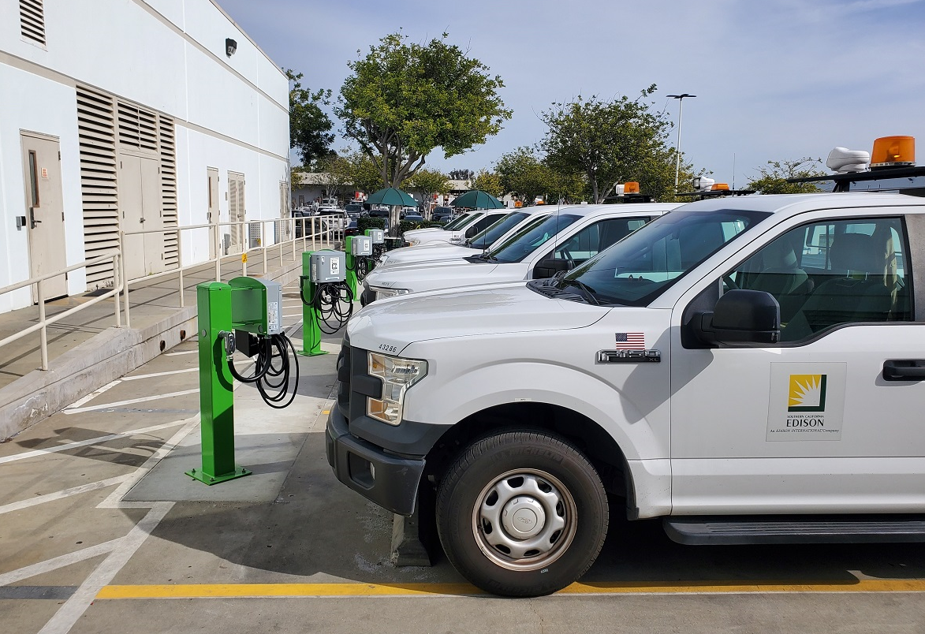
Overview
Opportunity and Scope
The expansion of EV use necessary to meet state climate goals requires technology leveraged in line with VGI principles
Fleet depots must optimize their electrification, while standard interfaces can provide grid resources
The SCOF project electrifies the vehicles and buildings at a fleet vehicle depot that hosts light, medium, and heavy-duty service vehicles in accordance with best BE and VGI practices, incorporating controls and DERs
A utility site energy management system interfaces with a utility grid management system, minimizing total energy costs while maintaining fleet operational integrity and using resources at the site to support the local grid
Deliverables
Test utility-owned microgrid control system configured to serve large, high-demand service centers, interfacing with charge management, fleet management, and building management systems, as well as utility-owned energy storage with secure communications
Demonstrate grid support functions
Build power outage resiliency to sustain EV charging essential for fleet operation
Test building electrification and management system, controlling a location with electric space and water conditioning
Use EV charging submetering and advanced metering options, including DC

Slide 35
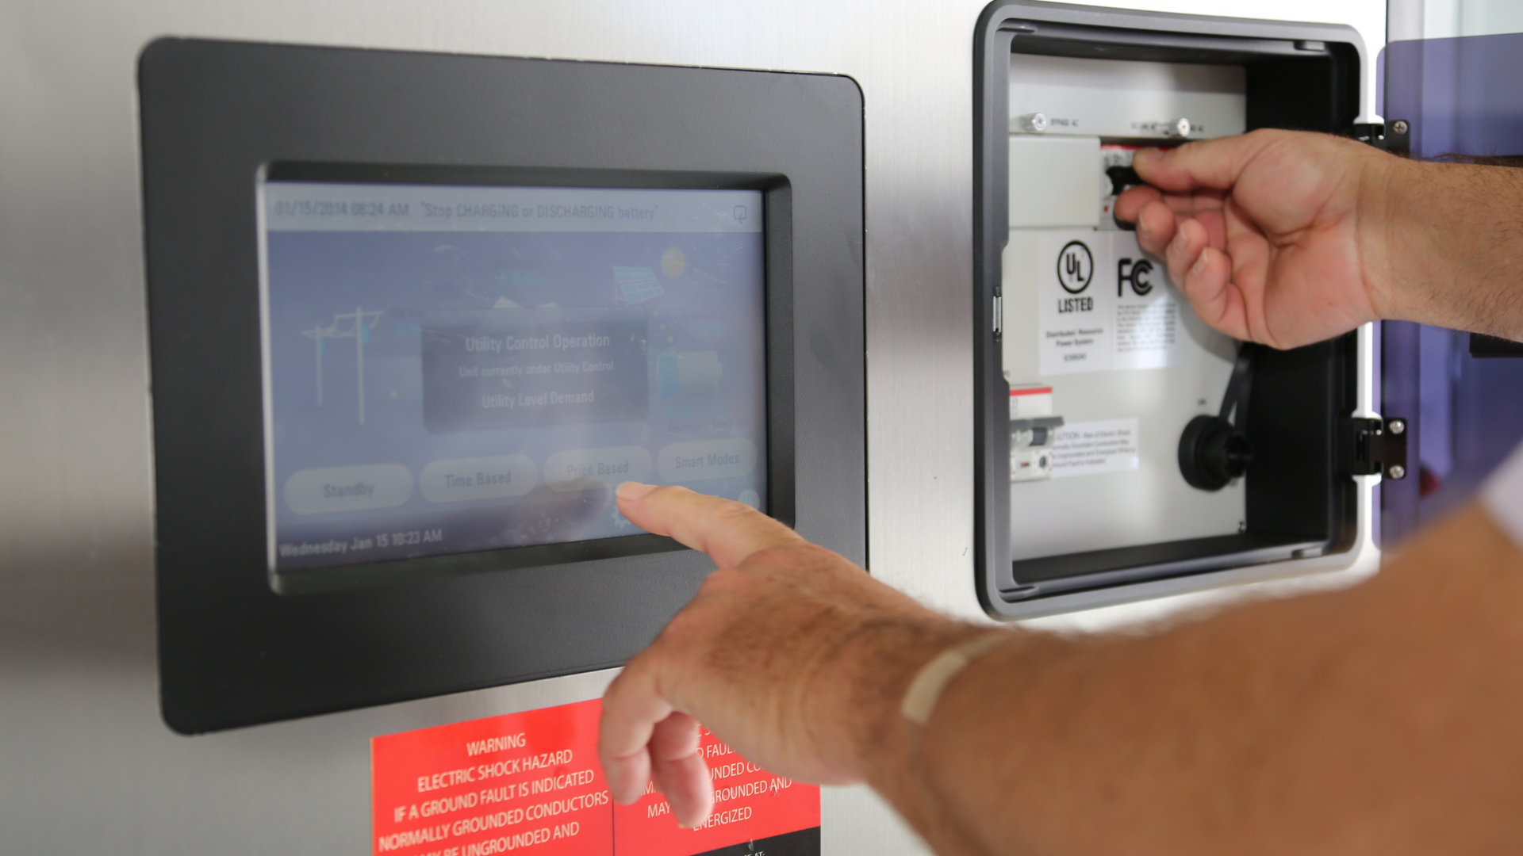
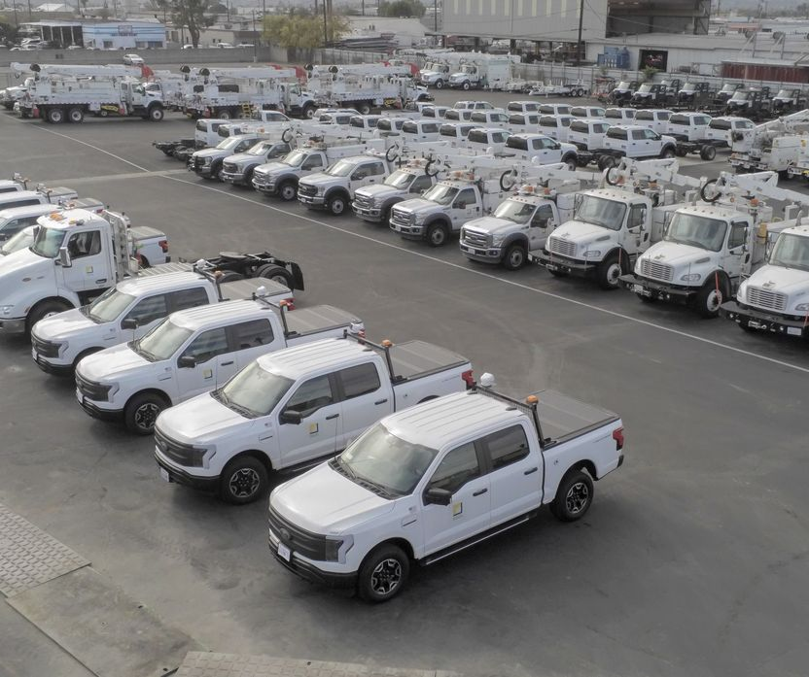
Location
Focus on SCE Service Center located in DAC – Dominguez Hills
One of largest SCE Service Centers in central location providing critical service – light, medium, and heavy vehicles
Local grid constraints

Slide 36

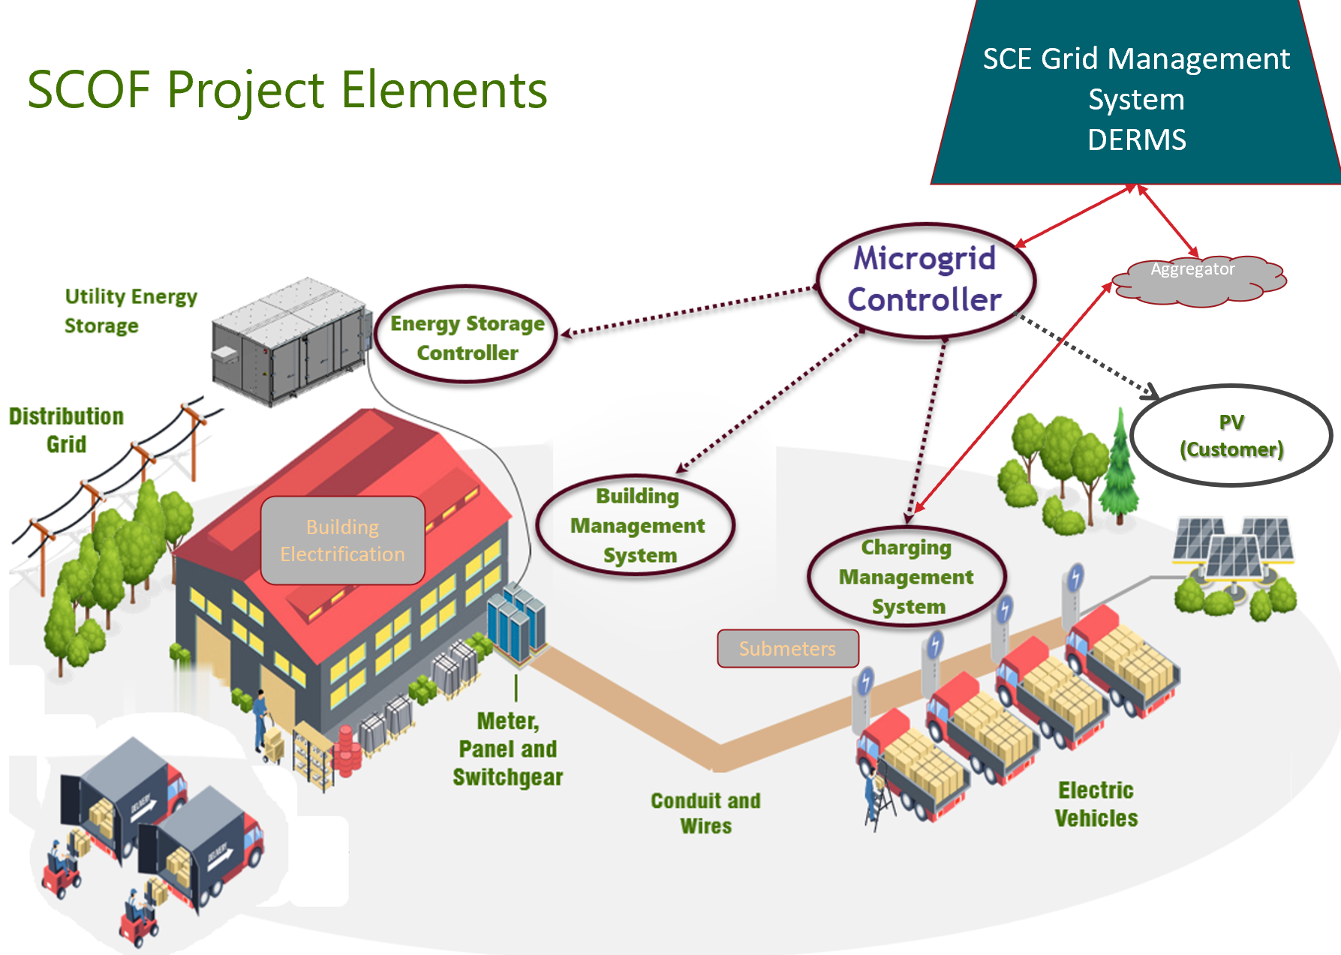
Project Elements
Microgrid control system configured with SEL
  Factory configuration and testing
  Protection designs
  SCE laboratory testing and simulations – Westminster labs controls test bed
  Power hardware in the loop testing – Pomona labs microgrid test bed
  Cybersecurity controls
  DERMS integration

Slide 37

Findings
Fleet management systems: Nascent and need to develop cybersecure standard communications
Charge management systems: Proprietary, emerging, need for systems integration
Microgrid control systems: System architecture and cybersecurity definitions
Energy storage integration: Siting and interconnection challenges

Slide 38

Stakeholders and Future Plans
Stakeholders:
  Internal: SCE Fleet, New Development Planning, eMobility, TE Roadmap, Integrated Planning
  External: CPUC, CEC, PG&E, SDG&E
  Working Groups: IEEE 2030.13, USDRIVE – GITT, National IWC
  Industry and Academia: IEEE, AQMD Clean Fuels Advisory Group
Potential EPIC 4 Plans
  System simulations using demonstrated load shapes and scenarios coupled with TE forecasts
  Additional storage and PV and other generation, V2G
  Autonomous systems, edge computing, DC service

Slide 39
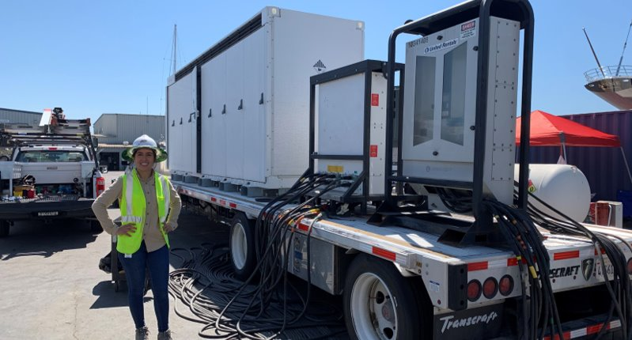
Mobile Battery Energy Storage Solution (MBESS)
EPIC 3, Project 7

Slide 40
MBESS Project Objective
CPUC Approved
The objective of this project is to undertake a pre-commercial demonstration of a mobile battery energy storage system (MBESS). The project will examine the possibilities for using a mobile battery at multiple locations within SDG&E’s service area.
An MBESS is a battery energy storage system on wheels that can provide multiple use cases based on a single MBESS application or a combination of several applications (stacking of applications) to provide grid support and reliability/resiliency solutions for utility projects and/or customers at different sites.
Included in the project are trials of IEEE 2030.5 to highlight the benefit and challenges associated with the communication protocol. Test cases will leverage 2030.5 as a means of controlling the MBESS to provide a demonstration of alleviating constraints on Operational Flexibility under specific scenarios.
The objective is to evaluate the effectiveness of mobile batteries when rotated between applications and identify preferred applications and strategy for the rotation.

Slide 41
Project Focus
Project Focus
Module 3
Additional Use Case Applications
Module 2
Quanta MBESS
Application
This third module of EPIC 3, Project 7 will include CPUC driven operational flexibility demonstrations using the IEEE communication protocol 2030.5 to communicate with the MBESS and in the future, customer owned DERs
The demonstrations will also include the deployment of the MBESS during planned outages, emergency events, and Public Safety Power Shutoff (PSPS) events.
Institute of Electrical and Electronics Engineers (IEEE) 2023.5 is a protocol to test inverter communications for renewable energy resources.
Notes:
Discuss how module 3 was voted upon as an additional phase for project 7 using remaining project budget as well as remaining funds from projects 3,4 and 5.

Slide 42
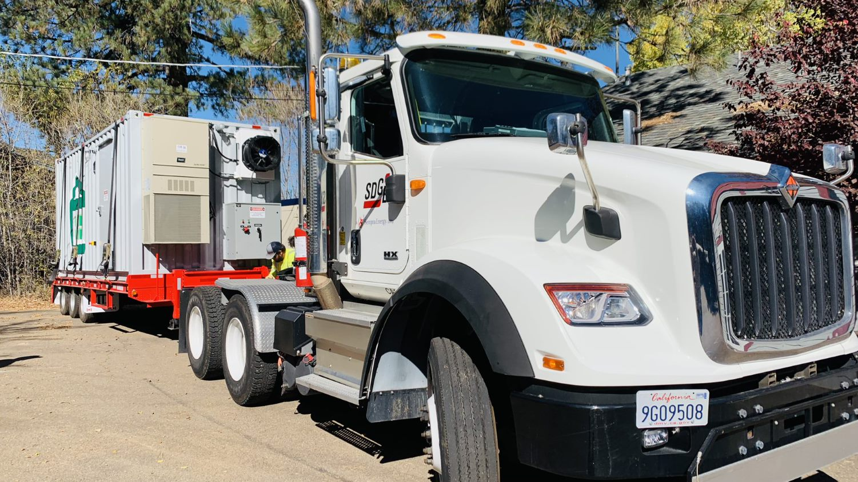
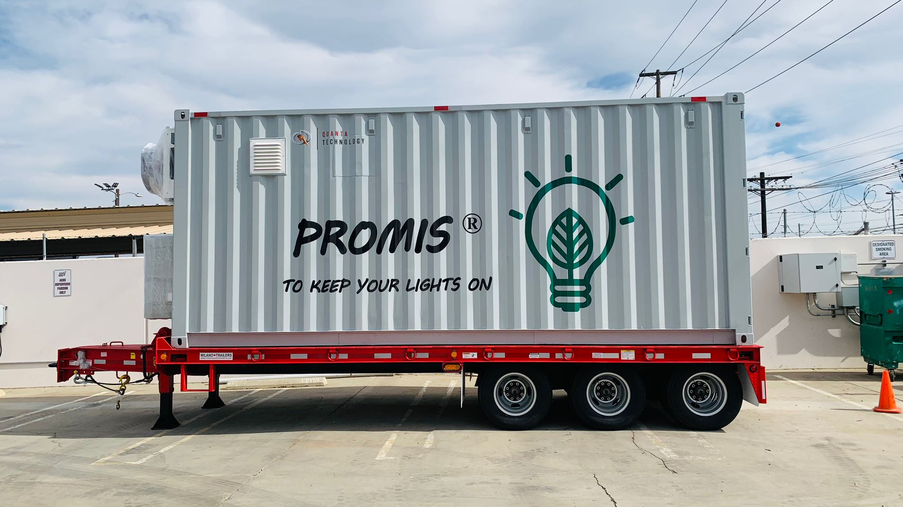
Mobile Batteries
Currently testing:
  100kW/225 kWh Battery
  Single phase 120/240V
  20ft trailer

Slide 43
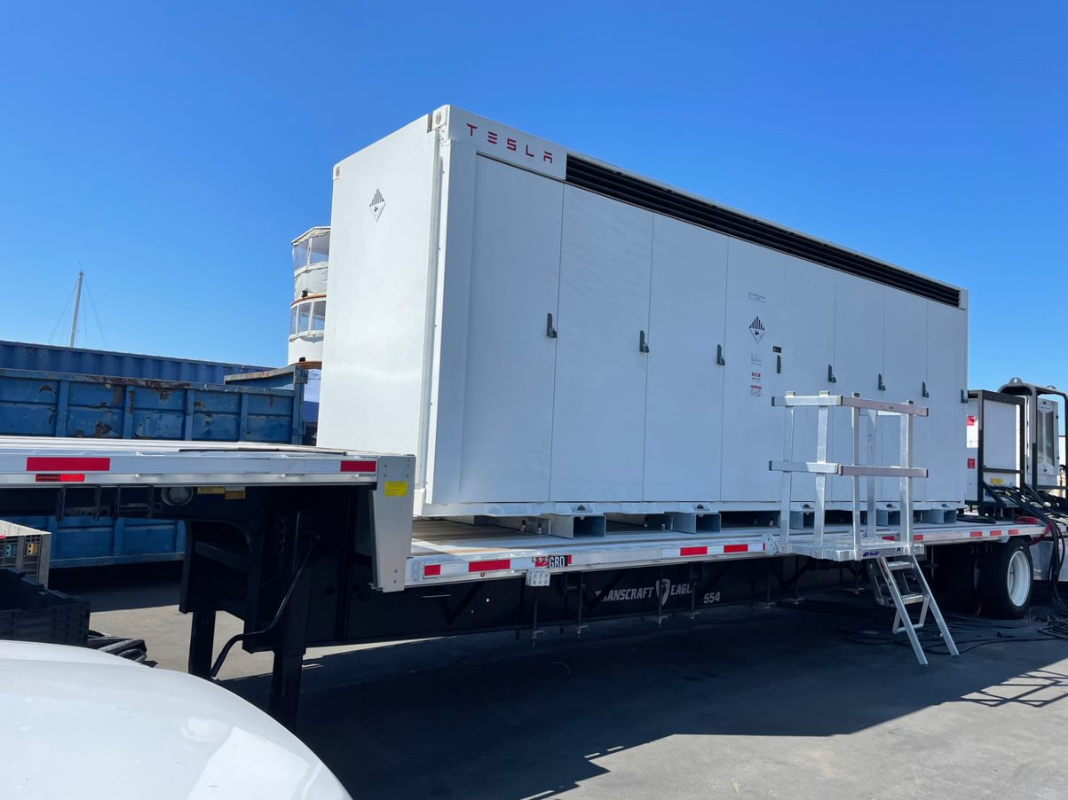
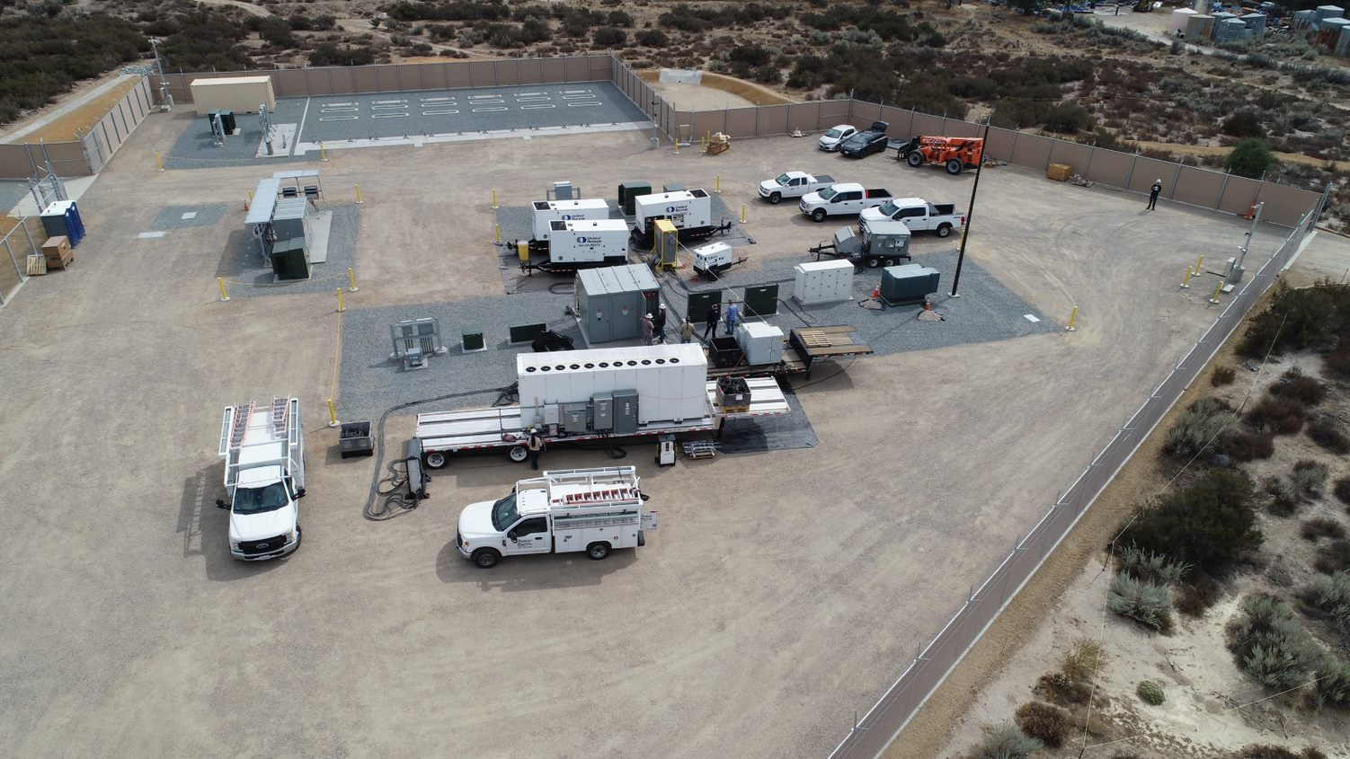
Mobile Batteries
Currently testing:
  362kW/1499 kWh Battery
  3 Phase 480V
  48ft Drop Deck Trailer

Slide 44
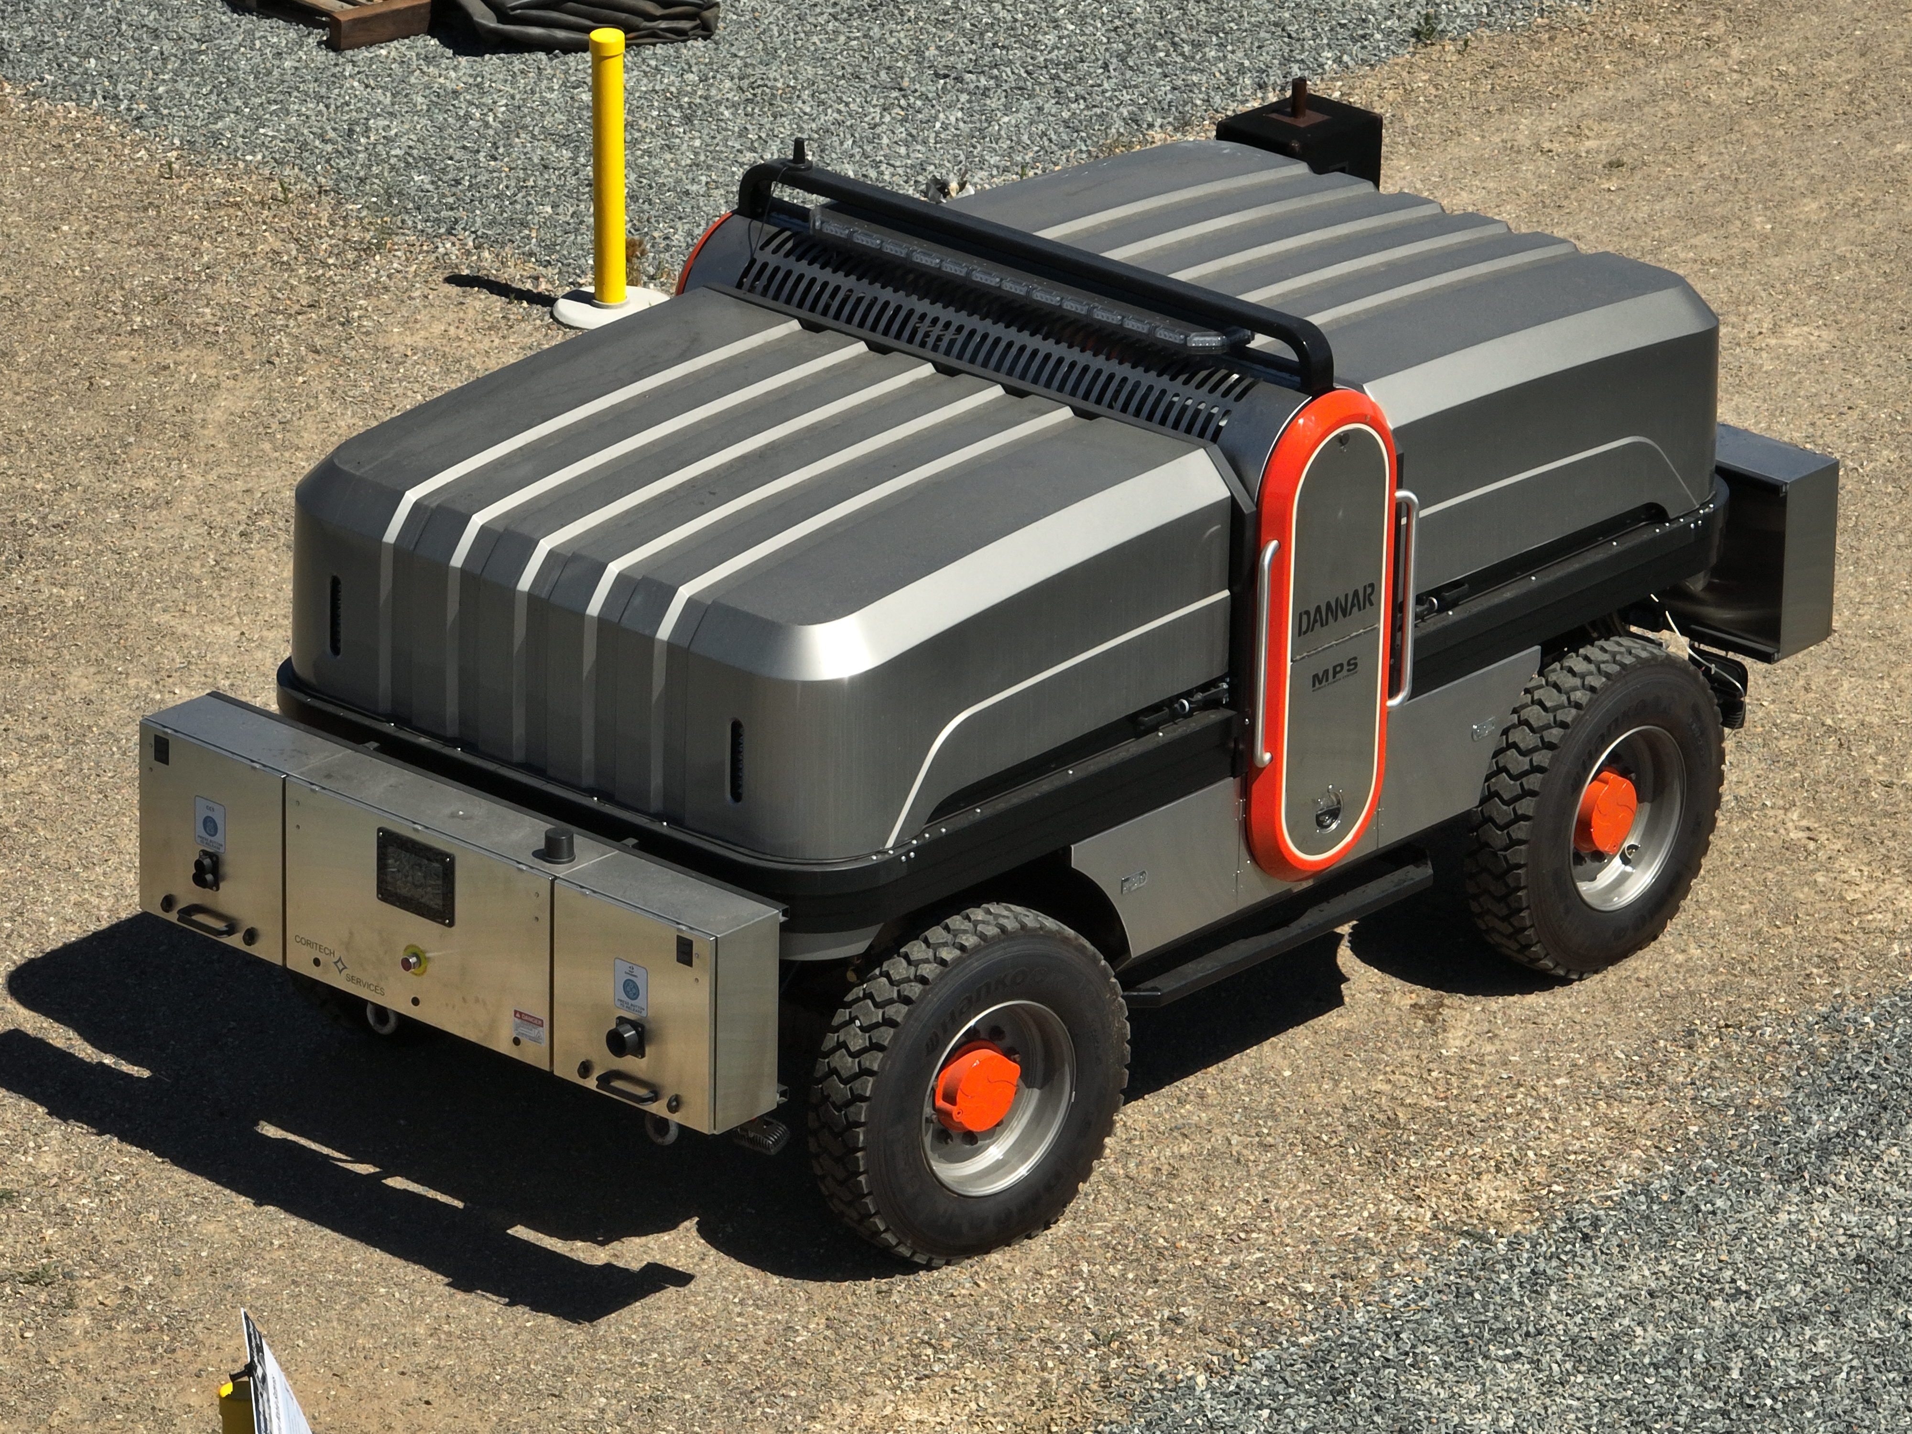
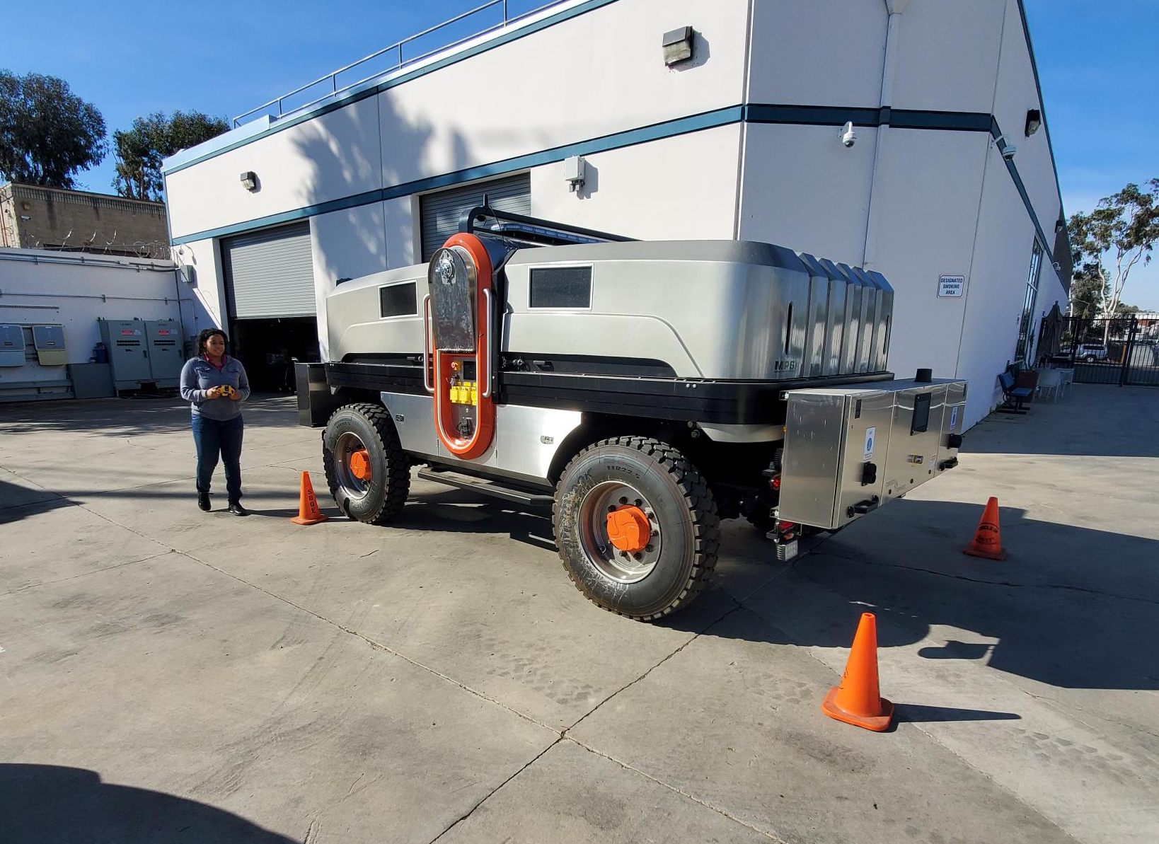
Mobile Batteries
Potential Future Use:
  14kW/500 kWh Battery
  Single Phase 120/240V
  Remote Controlled
  2 EV Chargers On board

Slide 45
Operational Flexibility Use Cases
For IEEE 2030.5 Protocol
Use Case | Grid Paralleling / Islanding
Operational Flexibility to Manage Constraints during Reconfiguration | Parallel to Grid
Capacity by increased Generation to Meet Requested Production | Parallel to Grid
Constant Voltage Boost | Parallel to Grid
Voltage Reduction | Parallel to Grid
Increased Mobility | Both
Notes:
CPUC identified these 4 use cases

Slide 46
Additional Use Cases
Use Case | Grid Paralleling / Islanding
Planned Outages | Islanding
Emergency Events | Islanding
Public Safety Power Shutoffs | Islanding

Slide 47
Summary of Initial Benefits Assessment for Module 3
Improved Operational Flexibility
Improved Operational Capacity
Evaluating the stacking of benefits, using two assets
Improved Reliability and Power Quality
Using a battery to facilitate power reduction or curtailments during abnormal circuit configurations
Coordinated dispatchable or scheduled electricity production
Improved Performance of Power System
Reduce outages associated with overloads, as well as voltage control. Use as backup power source during outages
Helps reduce electrical losses in the system

Slide 48
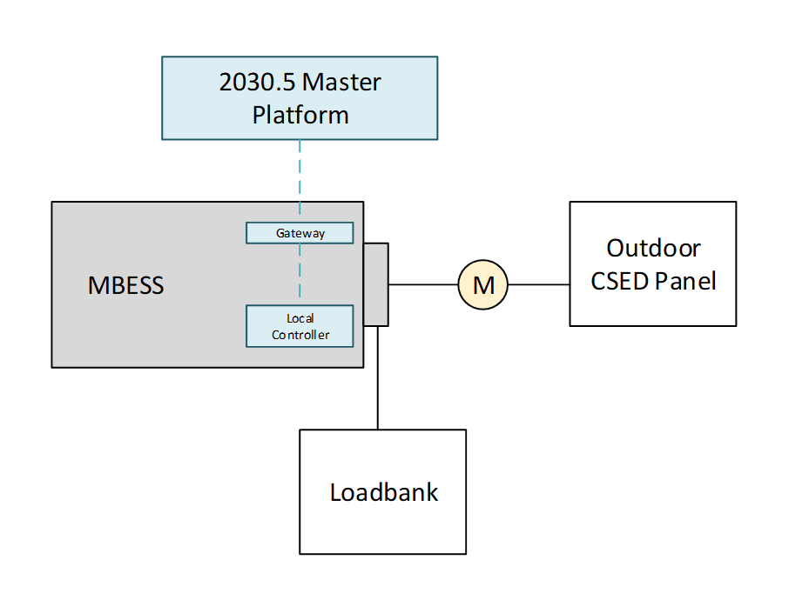
Module 3 Progress – for Operational Flexibility IEEE 2030.5
Test plan complete
Hardware installed
Integration testing complete
Currently conducting tests at the laboratory
CSED: Customer Service Electrical Device

Slide 49
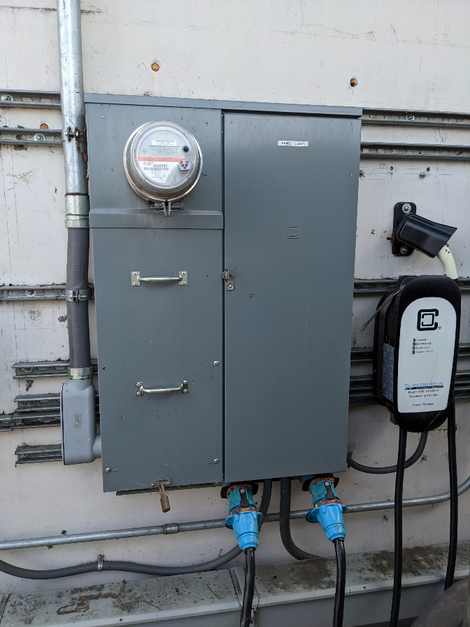
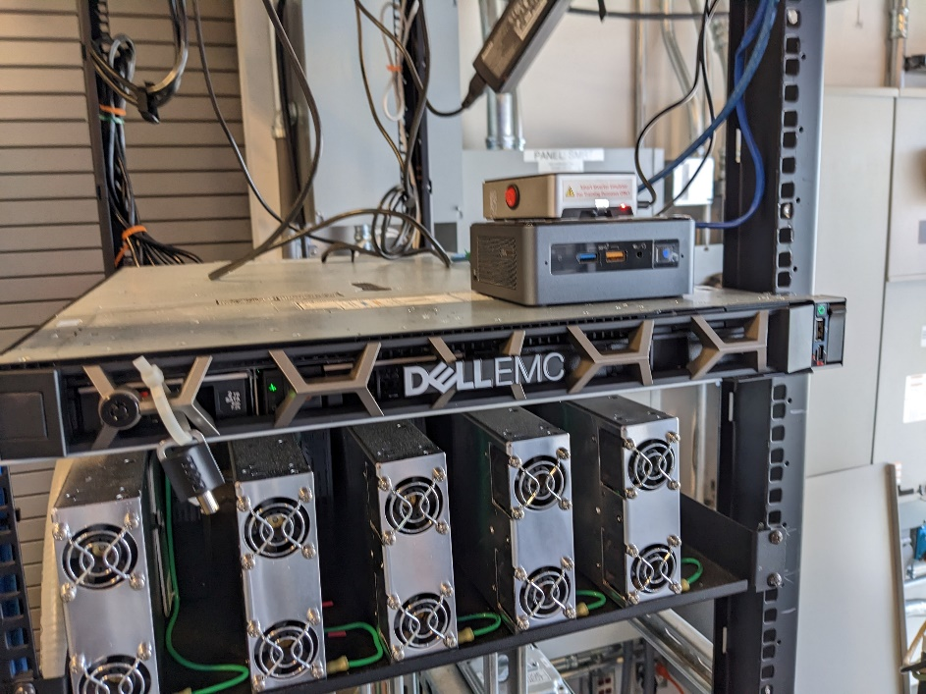
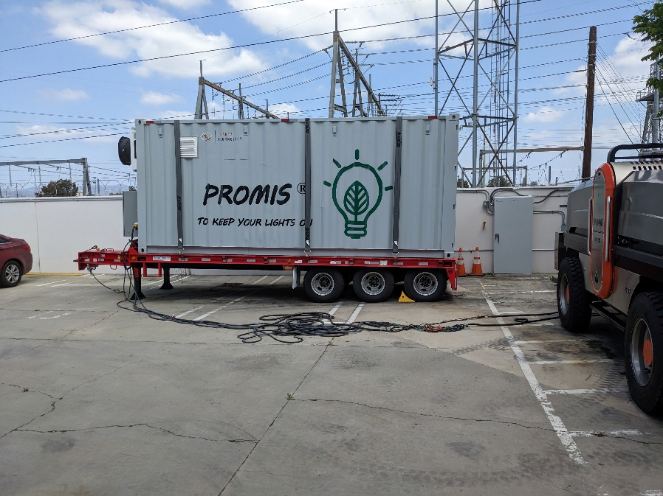
Module 3 Progress – for Operational Flexibility IEEE 2030.5
Dell blade server with Kitu Citadel installed
MBESS on trailer
Outdoor Customer Service Electrical Device (CSED) Panel

Slide 50
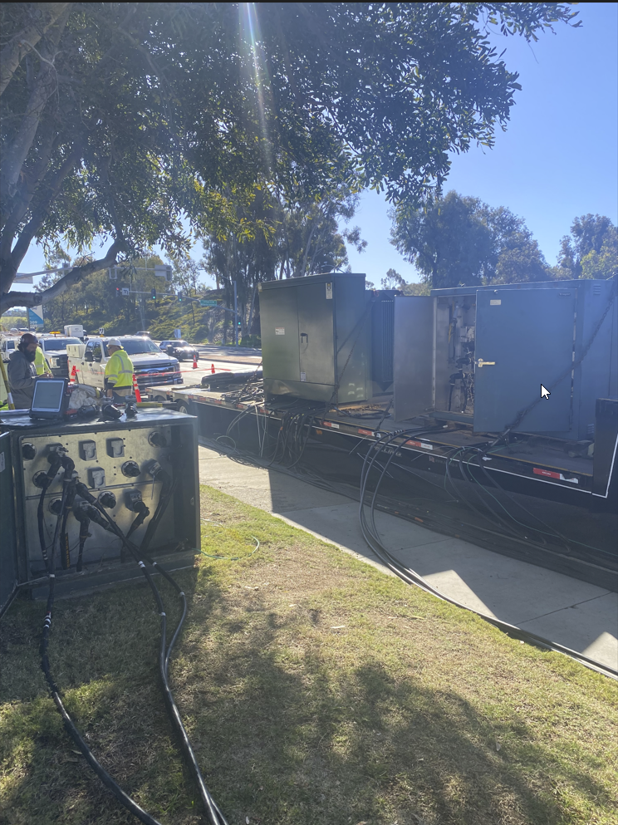
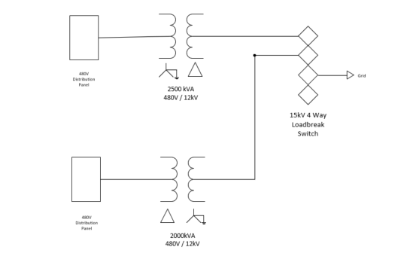
Plan for Additional Use Cases
Building a customized "Companion Trailer"

Slide 51
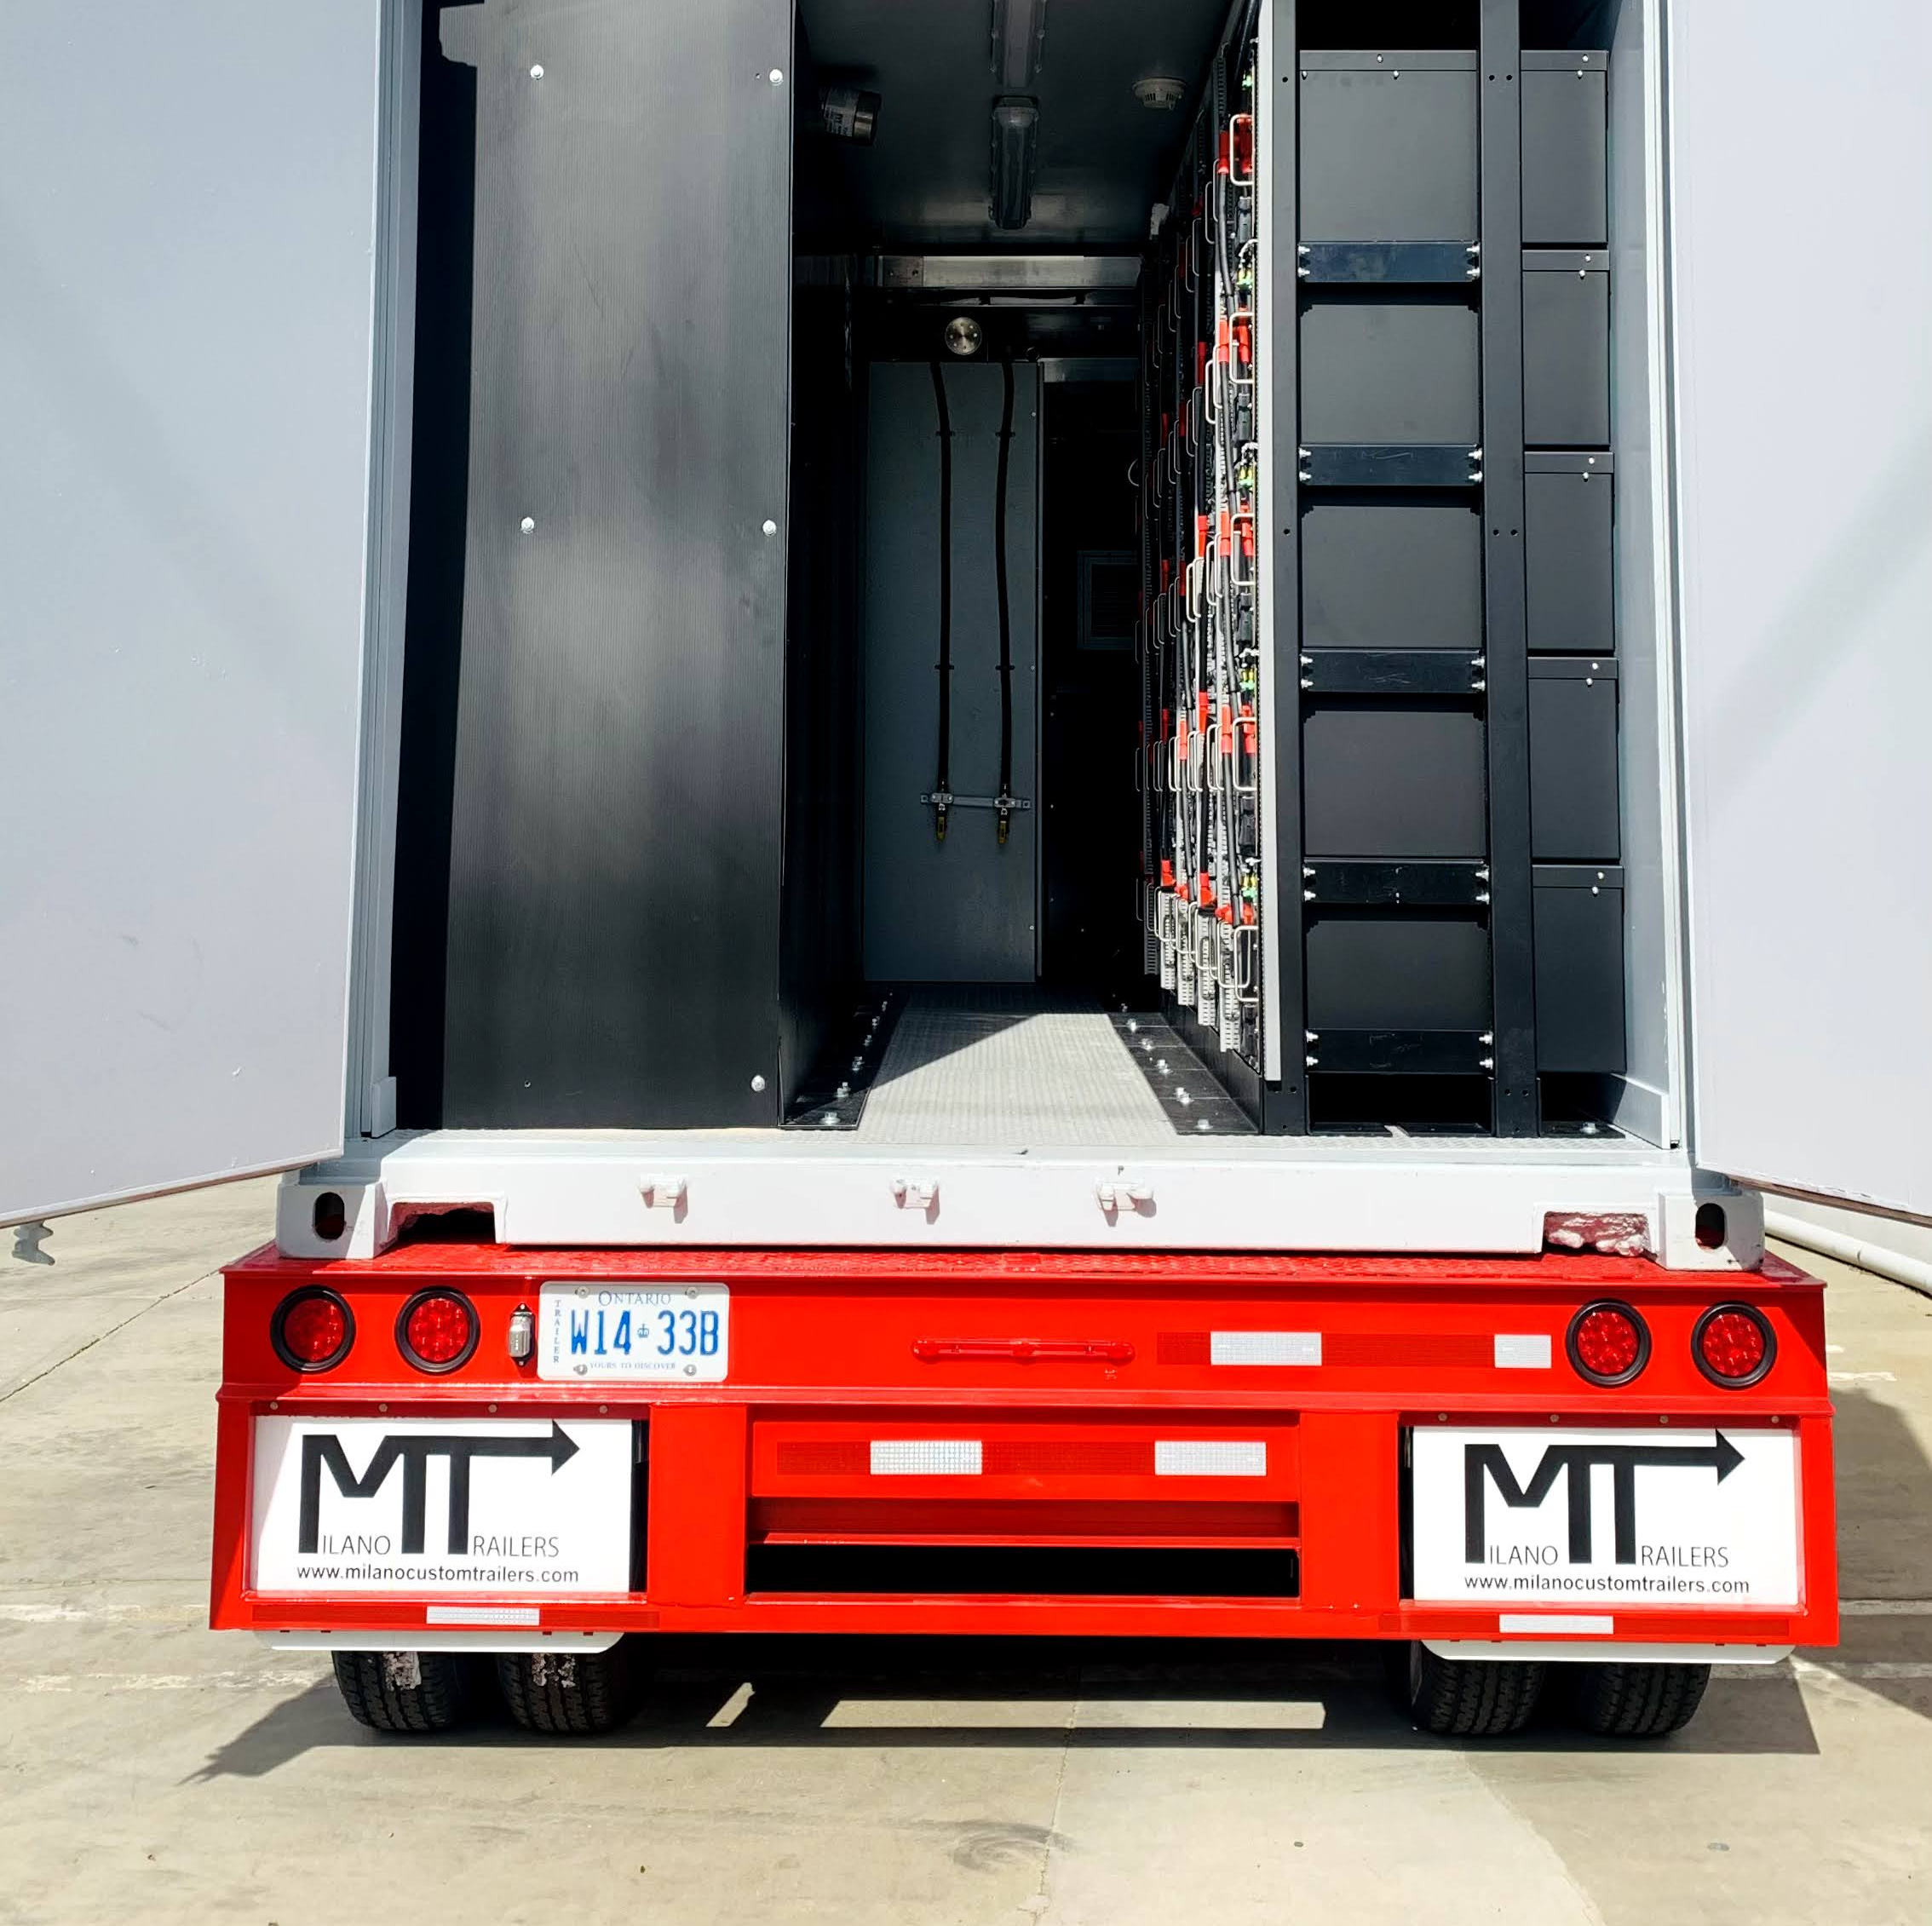
Problems or Issues Encountered
Module 3
Supply chain constraints
  Long lead times for equipment needed on mobile companion trailer
    Long lead times for new transformers and switch. Using one available at SDG&E, and a reconditioned unit that is readily available. Also reserved a switch is in stock

Slide 52
EPIC 3 to EPIC 4 – Work continues
Strategic Objective: Increase the Value Proposition of Distributed Energy Resources to Customers and the Grid Initiative – DER Integration
Research Topic Area: Integrated Distributed Energy Resources (“IDER”) Operational Flexibility
As DERs become more common in both commercial and residential applications, the demand for electric utilities to integrate and manage these resources to help maintain resilient and reliable power services is increasing. The benefits gained in this research topic area will provide real-world experience in seamlessly integrating greater amounts of DERs, while harnessing the flexibility of the demand side of the system to lay the foundation for operational flexibility.

Slide 53
Questions?

Slide 54
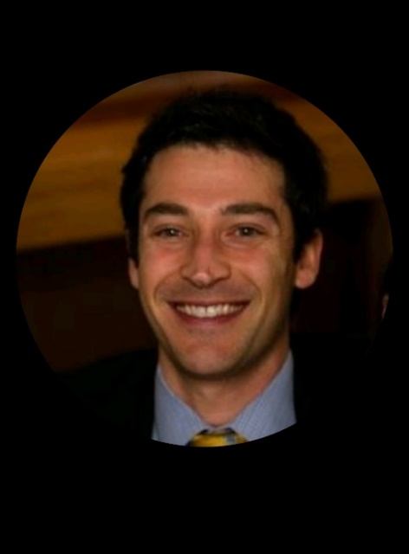
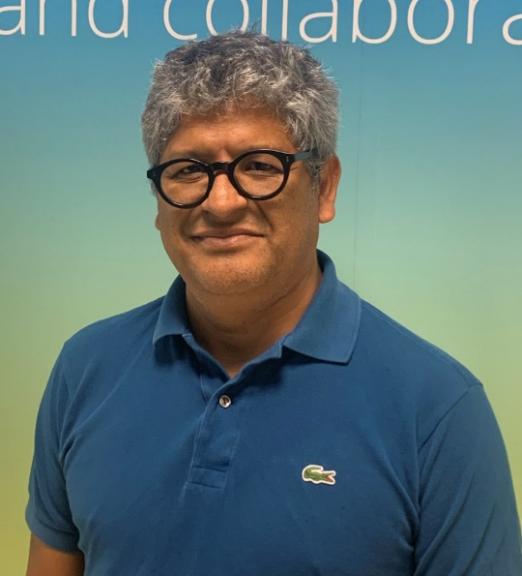
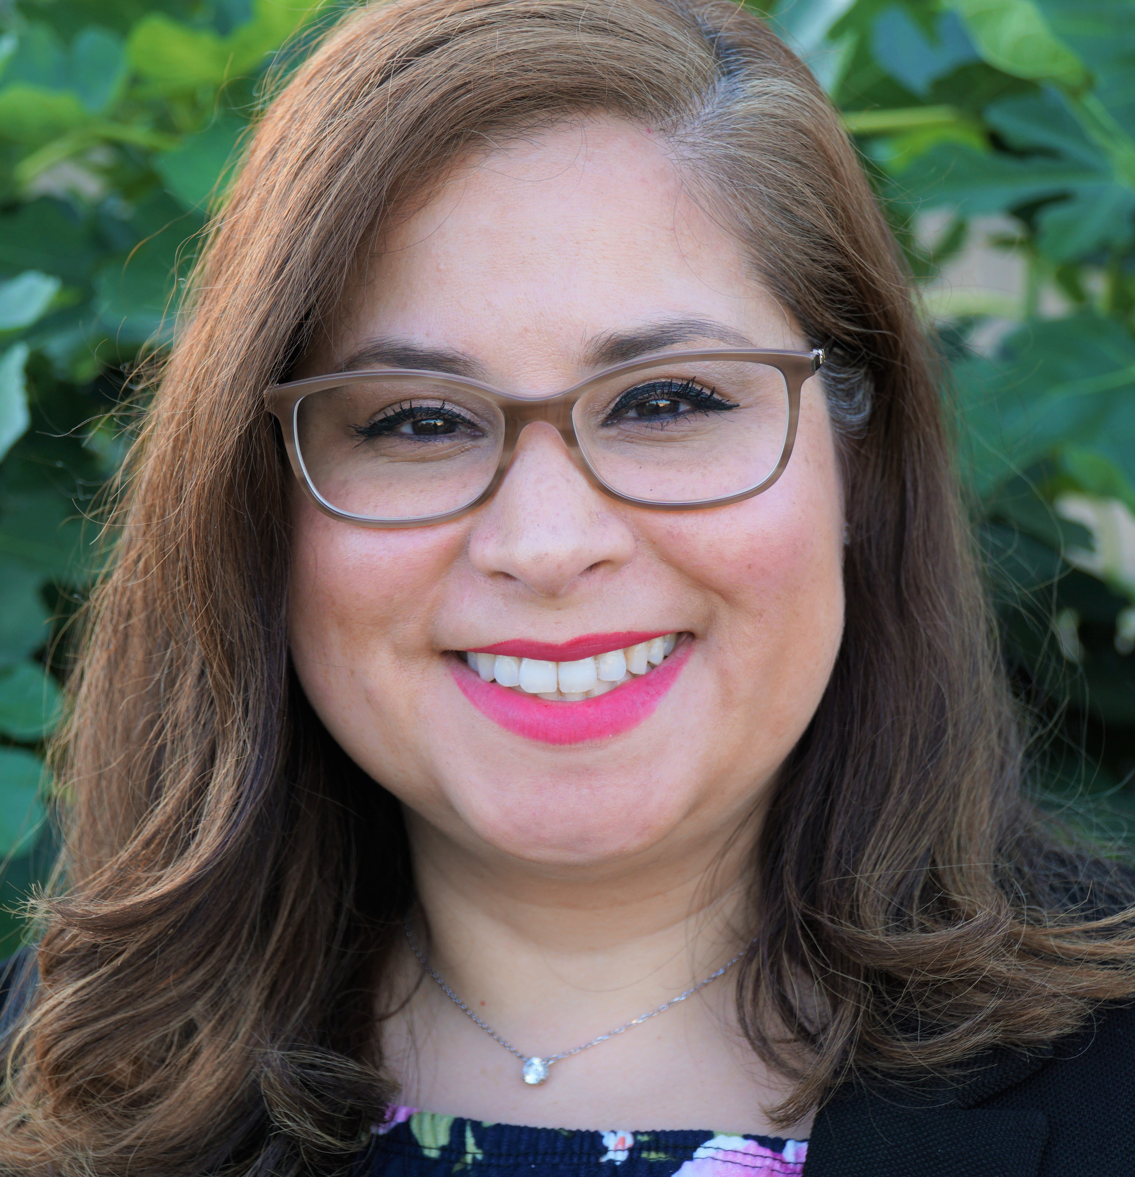
Collaboration Models
Dan Gilani
Senior Manager, R&D Operations
PG&E
Juan Castaneda
Principal Manager, Grid Technology Innovation
SCE
Cynthia Carter
EPIC Program Manager, Advanced Clean Technology
SDG&E

Slide 55
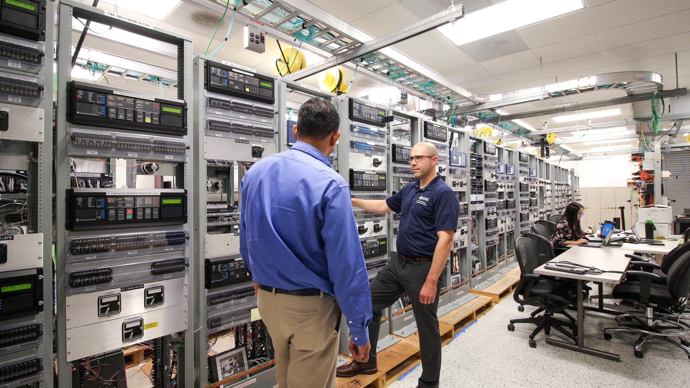
Current Mechanisms IOUs use to Engage in CEC EPIC Work
Offer a letter of support to a bidder
Offer a letter of commitment to a bidder
Offer to be on the technical advisory committee for whoever gets awarded the project
Partner with a bidder as a sub
Bid directly on a solicitation
Bid on a federal cost-share solicitation
Inform the scoping of solicitations

Slide 56
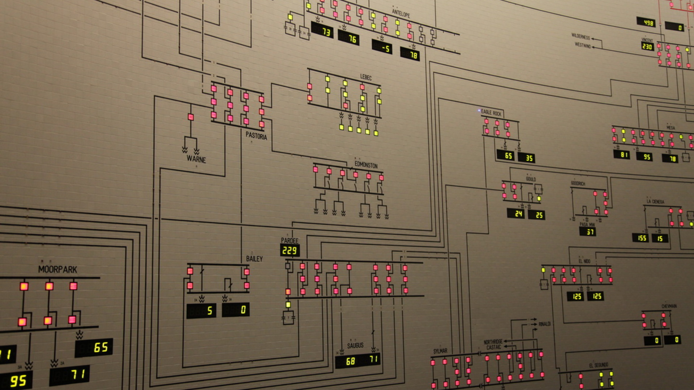
Example of CEC & SCE Collaboration
Electric Access System Enhancement (EASE)
Won 2022 Utility Transformation Project of the Year from the Smart Electric Power Alliance
Worked to streamline DER interconnections, improve supervisory access to grid assets and DERs, and optimize DERs for grid reliability and market-based energy services
Concluded in March 2022 and was supported by the DoE Enabling Extreme Real-time Grid Integration of Solar Energy program and the CEC’s EPIC program as federal cost share
Project team included Smarter Grid Solutions, Opus One Solutions, Kitu Systems, Inc, Clean Power Research, Inc, National Renewable Energy Laboratory, and the City of Santa Ana

Slide 57
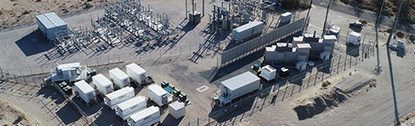
Example of CEC & SDG&E Collaboration
CEC was the grant provider for SDG&E’s Borrego 2.0, "Borrego Springs: California's First Renewable Energy-Based Community Microgrid“
CEC’s role was as the program manager, and they oversaw the deployment of SDG&E’s first advanced microgrid controller
SDG&E provided data to CEC from demonstrations
Notes:
Borrego Springs deals with extreme weather (heavy rainstorms, extreme cold, and extreme heat). [For your information, it’s not located within a DAC though]
The community is at the end of the one and only transmission line in the area.

Slide 58
Example of CEC & PG&E Collaboration
Redwood Coast Airport Microgrid (RCAM)
CEC awarded SERC through an EPIC 2 solicitation, building on CEC’s portfolio of microgrid research projects aimed at technology advancement towards commercialization.
PG&E provided a commitment letter and executed an EPIC 3 sister project to develop design standards, testing capabilities, and DCC infrastructure to support operations within the utility-owned distribution grid.

Slide 59
Needs and Opportunities

Slide 60
Q&A

Slide 61

Closing Remarks from SCE Principal Manager of Grid Technology Innovation Juan Castaneda

