Slide 1
Catalina Island Water Pipeline Project
Serving Two Harbors and Surrounding Area
Community Informational Meetings
Two Harbors and Avalon
July 27, 2023

Slide 2
Spanish Interpretation Available

Slide 3
Welcome!

Slide 4
Provide information about the Catalina Island Water Pipeline Project
Hear your questions and provide answers, and learn about your perspectives and input too
Collect contact information so that we directly send updates to you
Today’s Meeting
Thank you for being here!

Slide 5
Community Meeting Format
Team Introductions
Presentation: Project Information
Q&A
Conversations with Team Members at Stations
*Spanish interpreter attending both meetings

Slide 6




Opportunities to Participate
Q&A Session*
Input
Card
Station Conversations
*For Q&A session, please write your question on an index card and give it to the facilitator

Slide 7
Meet the
SCE Team

Slide 8
Southern California Edison provides water, gas, and electricity service to homes, businesses, recreational and community facilities across Catalina Island.
For water, our priority has been and is to safeguard drinking water, protect the environment, and provide reliable and affordable water service today and in the future.
Since the 1960s

Slide 9
Much of the water supply infrastructure was built in 1960s, using materials and technologies that were commonly used across the country and met the industry standards of that time.
The infrastructure is aging and some infrastructure contains materials now regulated due to potential health risks.

Slide 10
Two Materials Commonly Used in 1960s Infrastructure Are Now Regulated due to Potential Health Risks
PCBs
______________
Polychlorinated biphenyls
______________
__________
Subject to the U.S. Toxic Substances Control Act and regulated by the U.S. Environmental Protection Agency (EPA)
PAHs
______________
Polycyclic aromatic hydrocarbons
______________
__________
Subject to the California Toxicity Criteria Rule and regulated by the State of California Department of Toxic Substances Control (DTSC)
Sometimes found in pipeline coatings

Slide 11
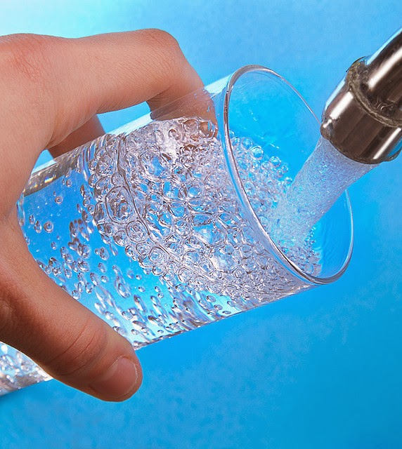
Important
The drinking water is safe.
SCE, like other utilities around the country, is proactively addressing the situation and taking action to comply with all regulations.
SCE is committed to providing safe water, protecting the environment, and ensuring reliable and affordable water service.

Slide 12
Catalina Island Water Pipeline Project
What’s Happened So Far
Completed removal of out-of-service pipeline and tested soil
Identified approximately 8 miles of in-service Two Harbors Pipeline that contains PCBs and PAHs
Developed and submitted soil remediation plans for out-of-service pipeline area

Slide 13
Catalina Island Water Pipeline Project
What’s Next
Conduct pilot study for soil remediation
Finalize plan for removal, remediation, and replacement
Implement Two Harbors pipeline replacement project
Ongoing community engagement
These assessments and actions – and the coordination with the regulatory agencies – is a complex, long-term, multi-year process

Slide 14
Catalina Water Pipeline Project
Key Takeaways
This is a multi-year project.
Project involves removal of soil in an environmentally responsible manner under the oversight of state and federal agencies.
The drinking water is tested regularly and safe.

Slide 15
SCE Priority: Consistent and Frequent Community Engagement
Community Meetings
Fact Sheet & FAQ Questions/Answers
Mailed Materials
Website
Dedicated Email Address
Call Center
Share Information
Answer Questions
Solicit Input

Slide 16
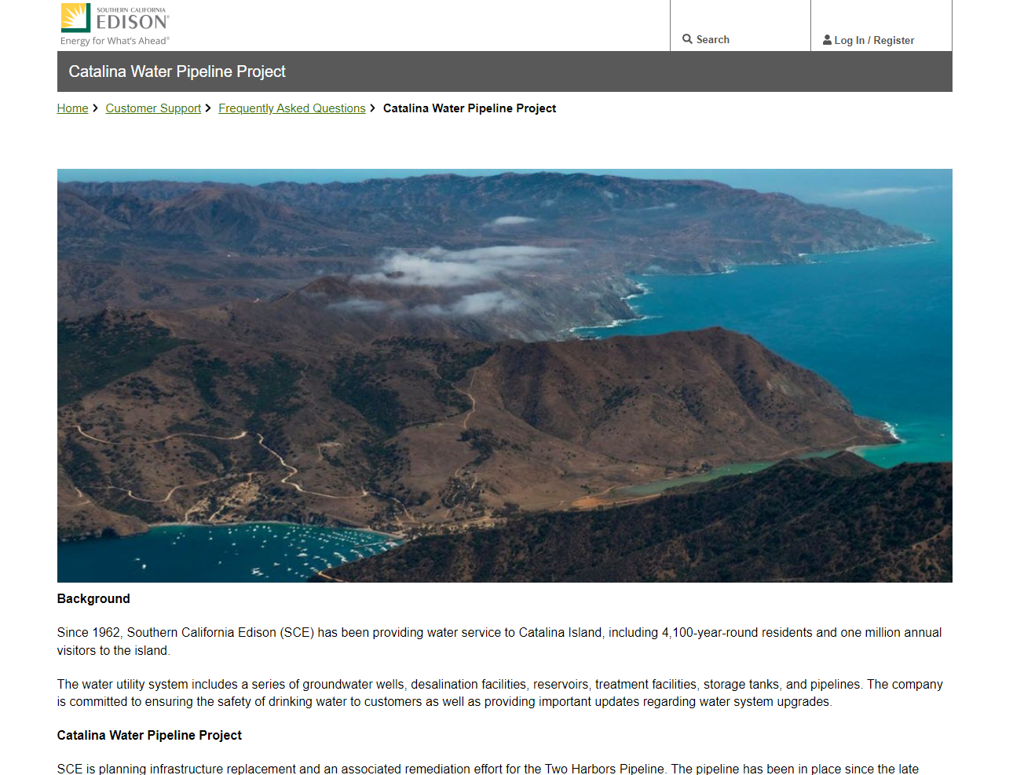

Slide 17
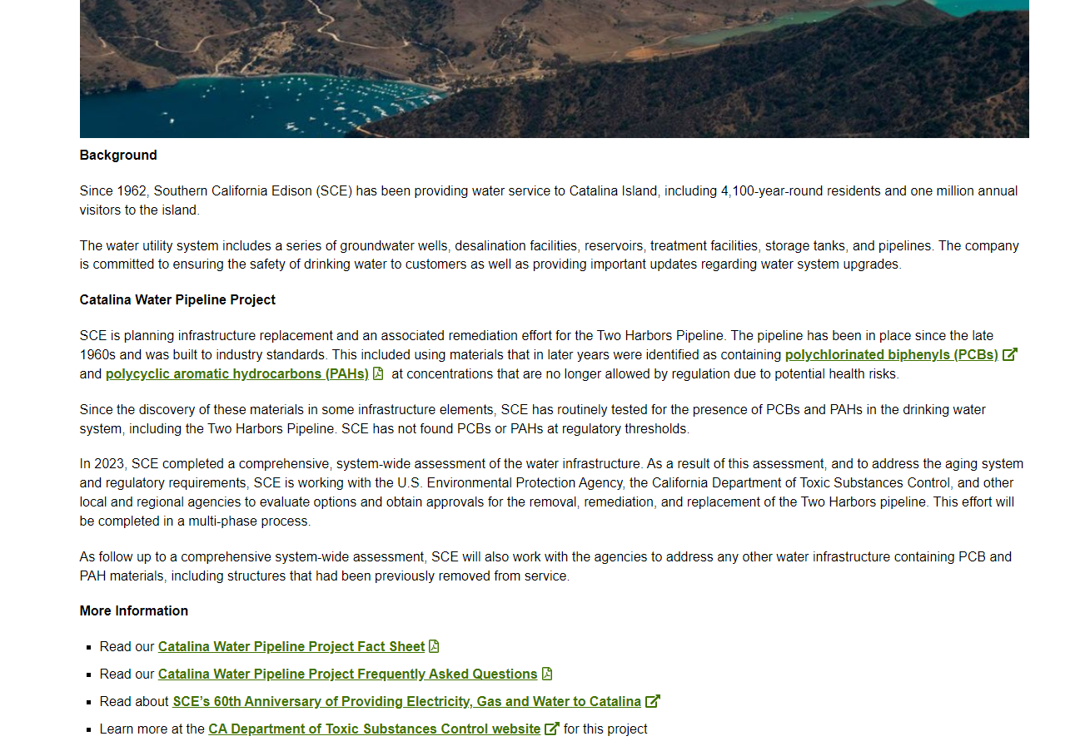

Slide 18


California Department of Toxic Substances Control
Public Involvement Program
The California Department of Toxic Substances Control (DTSC) also prioritizes public engagement
July: DTSC mailed survey to Catalina Island community members
Purpose: To ask community members about their preferences for receiving information and participating in outreach processes.

Slide 19
Q&A

Slide 20
Opportunities to Participate
Q&A Session*
Input
Card
Station Conversations
*For Q&A session, please write your question on an index card and give it to the facilitator

Slide 21
Q&A

Slide 22
SCE Priority: Consistent and Frequent Community Engagement
Community Meetings
Fact Sheet & FAQ Questions/Answers
Mailed Materials
Website
Dedicated Email Address
Call Center
Share Information
Answer Questions
Solicit Input

Slide 23
Thank You
See you at the information stations, and please fill out input cards

