Slide 1
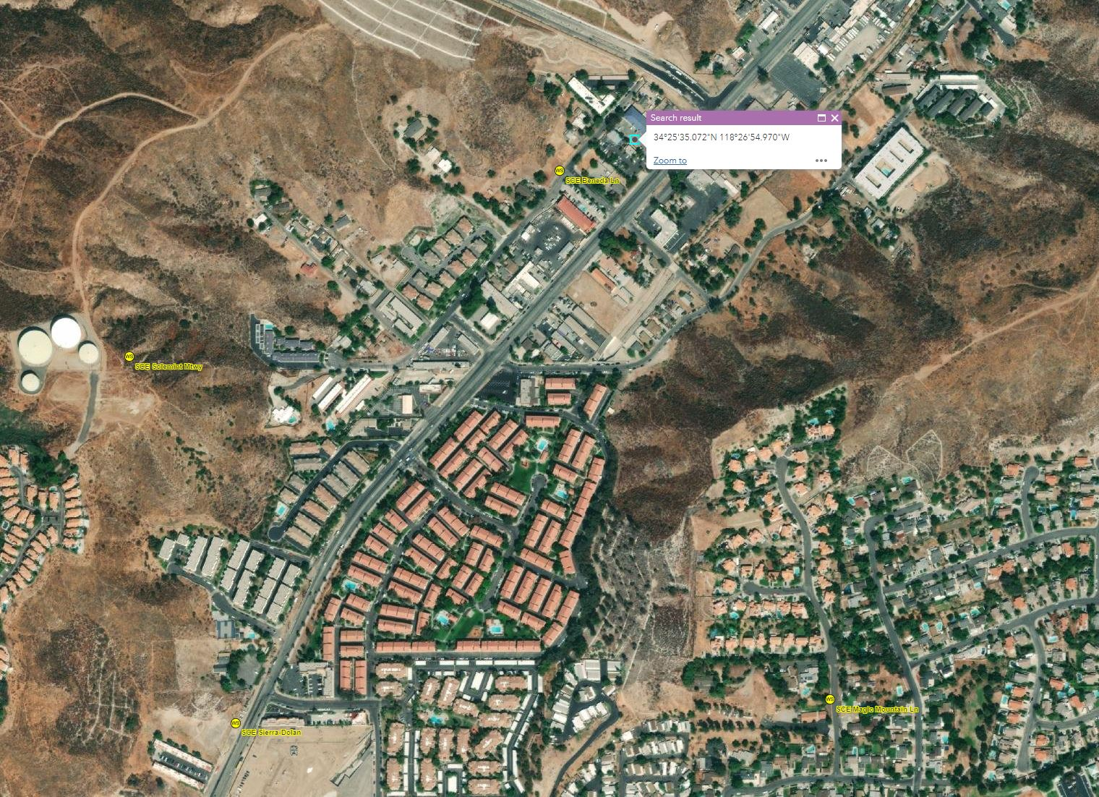
Review of wind profiler output for October 12, 2021
LiDAR observations were obtained for the period of October 12th from 1 am to 12 pm.
Fire Sciences compared LiDAR data with forecast model time-height cross sections at the nearest grid cell to where the LiDAR unit was located.
Fire Sciences concluded that wind profiler data matched relatively well with forecast model wind speeds at their respective heights.
Fire Science worked with atmospheric model vendor, ADS to discuss results and possible improvements to SCE’s in-house weather models.
ADS and Fire Science concluded that many more LiDAR deployments would need to occur, and that high resolution model data (100 m) would need to be run during deployments to better understand model performance and potential improvements.

Slide 2
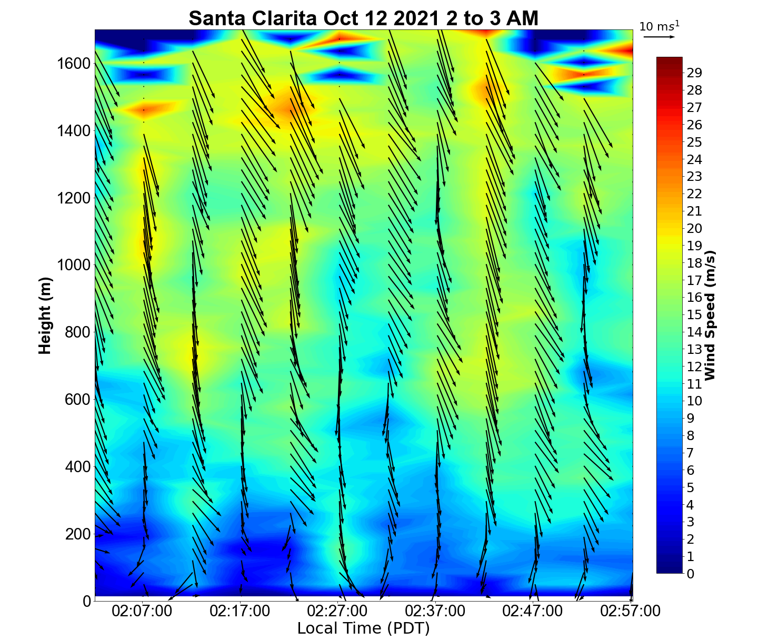
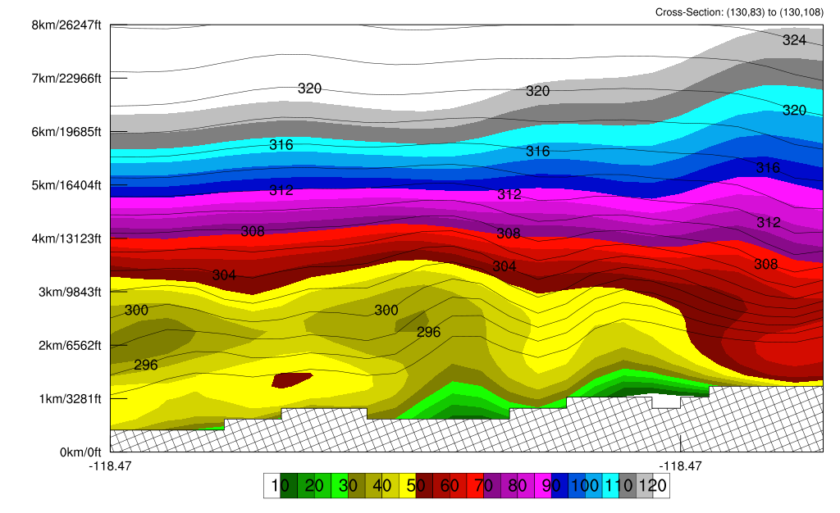
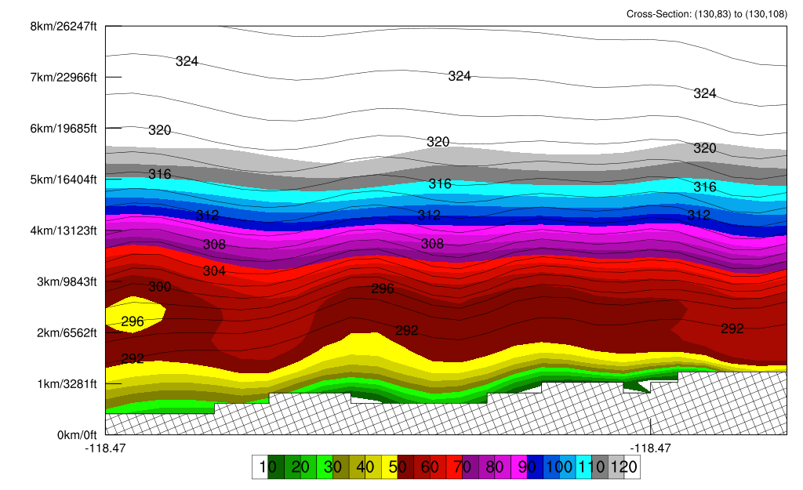
Review of wind profiler output for October 12, 2021
A
B
A
B

Slide 3
Review of wind profiler output for November 20-22, 2021
LiDAR observations were obtained for the period of November 20th at 9:30PM through November 22nd at 11AM
Fire Sciences compared LiDAR data with nearby SCE weather stations
Fire Sciences concluded that wind profiler data matched well with observed surface winds
Fire Sciences also concluded that there was little or no predictability for when stronger winds aloft would surface

Slide 4
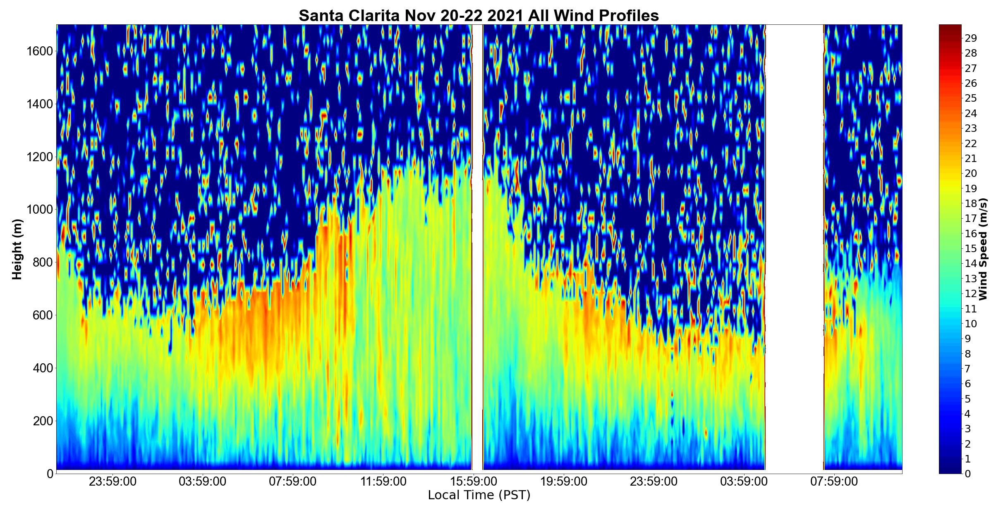
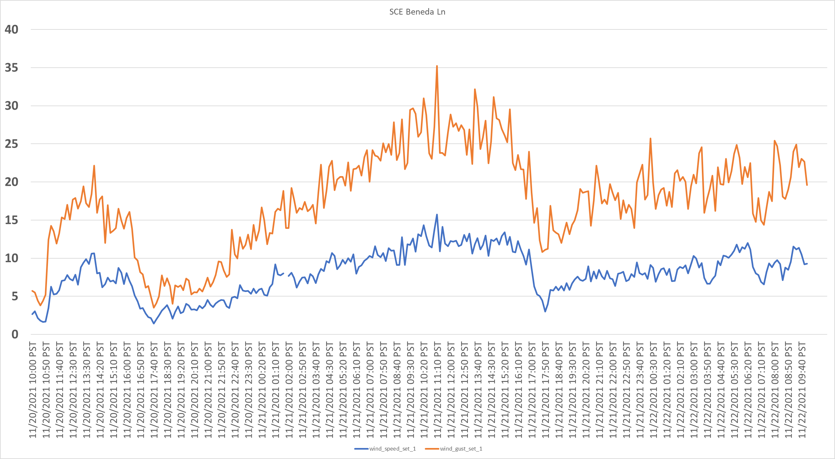
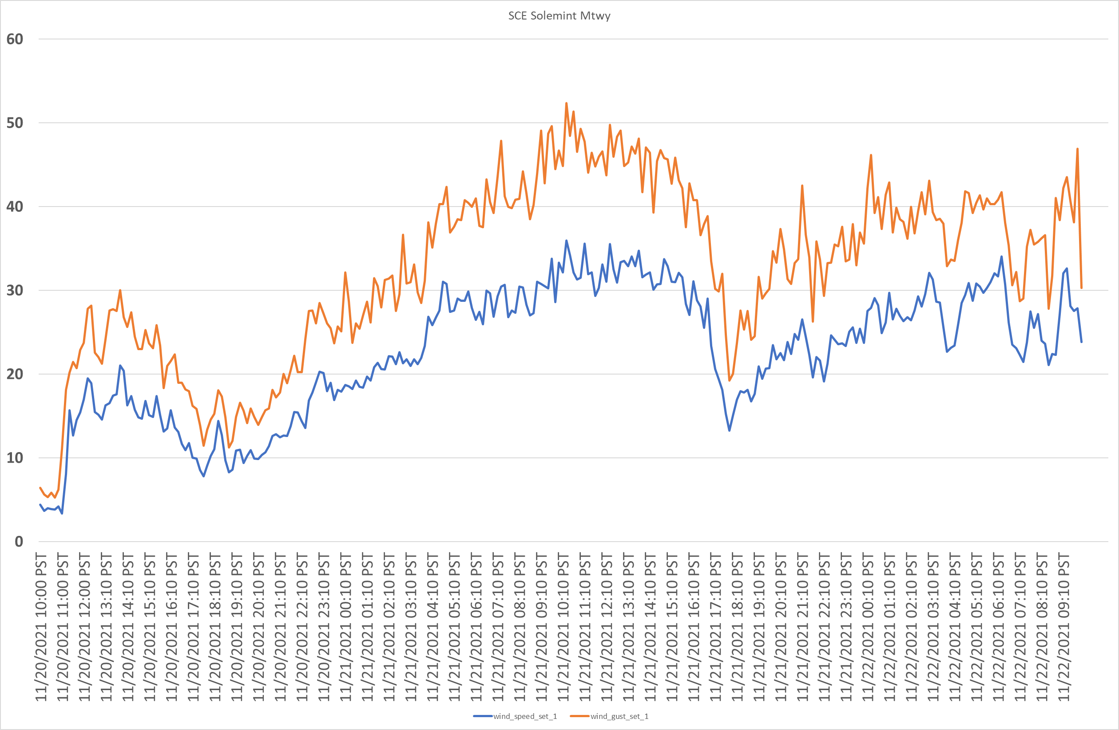
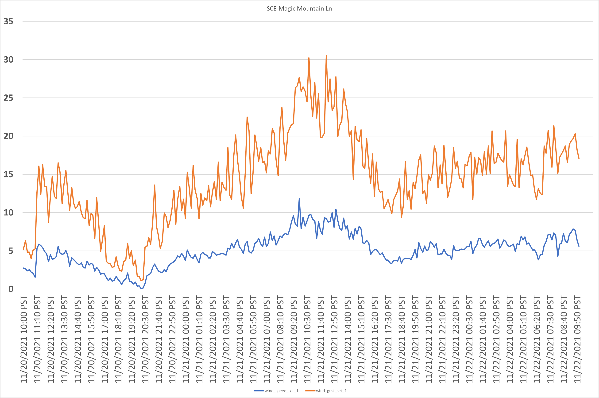
Surface Observations

